Slide 1

ReMind
Under Supervision of:
Dr. Shaimaa Galal
Eng. Aliaa
Mid-Year Discussion
Academic Year 2024/205
1

Slide 2
Team Members
Name | ID
Aya Mohamed Abdelrahman | 20211020
Karin Khair Abdallah Mataa | 20210292
Shimaa Amer Mohamed | 20211056
Mahmoud Sayed Abdel’aty | 20210370
Mario Malak Alabd | 20210313
Mahmoud Ali Abdelmnam | 20210371
2

Slide 3
Table of contents
01
02
03
04
05
06
Problem Definition
Motivation
Objective
Market Analysis
Solution
Stakeholders
07
08
09
ML & Location
Prototype
3
Architecture & Technologies

Slide 4
Problem Definition
02
03
04
01
05
06
07
08
4
09

Slide 5
Problem Definition
02
Motivation
01
03
Memory-related challenges impact daily life, especially for individuals with cognitive impairments.
Forgetting important tasks, medications, or appointments can lead to serious consequences.
Existing reminder systems lack personalization and adaptability to individual needs.
Staying with a caregiver in same place all time isn’t an efficient solution.
The current landscape lacks a smart, user-friendly, and unified solution for effective memory assistance.
04
05
06
07
08
5
09

Slide 6
02
01
03
04
05
06
Motivation
07
08
6
09

Slide 7
01
02
Motivation
03
Alzheimer's impairs memory, challenging patients and caregivers.
Traditional care is inefficient, requiring constant supervision.
Technology boosts patient independence and reduces caregiver strain.
Emergencies can occur unexpectedly in our interconnected world.
ReMind integrates AI, tracking, and reminders for better support.
Objective
04
05
06
07
7
08
09

Slide 8
03
Objective
01
02
04
05
06
07
08
8
09

Slide 9

Objective
01
03
02
Our project aims to tackle these issues by:
Developing smart and adaptive reminder solutions.
Creating a comprehensive platform that supports individuals with memory challenges.
Helping users manage daily tasks, medications, and appointments efficiently.
Providing remote monitoring and assistance without requiring constant physical presence.
Track and monitor people you care about.
By Addressing these concerns, we strive to make our world safer and healthier place for everyone.
04
Market Analysis
05
06
07
9
08
09

Slide 10
04
Market Analysis
01
02
03
05
06
07
08
17
09

Slide 11
01
04
Market Analysis
02
Feature | Alzbetter | AlzConnectd | Alzheimer’s App | CaringBridge | Life360 | Care Partner
Symptom tracking | _ | _ | ✔ | _ | _ | _
Reminders for medication | _ | _ | _ | _ | _ | ✔
Community support | ✔ | ✔ | _ | ✔ | _ | _
Location tracking | _ | _ | _ | _ | ✔ | _
Personalized resource library | _ | _ | ✔ | _ | _ | _
03
05
Solution
06
07
18
08
 | Not mainly focused on Alzheimer
09

Slide 12
05
Solution
01
02
03
04
06
07
08
10
09

Slide 13



Solution
05
Memory Tests
Important Dates Reminder
Medical Reminders
Patients receive reminders for medical appointments, birthdays, and important events, helping them stay connected and organized.
Automated alerts help patients take their medications on time, preventing missed doses. Caregivers get notified if a reminder is skipped.
Engaging memory games help stimulate cognitive function and slow decline, while also tracking the patient’s progress over time.
11

Slide 14
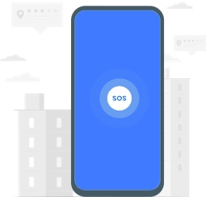
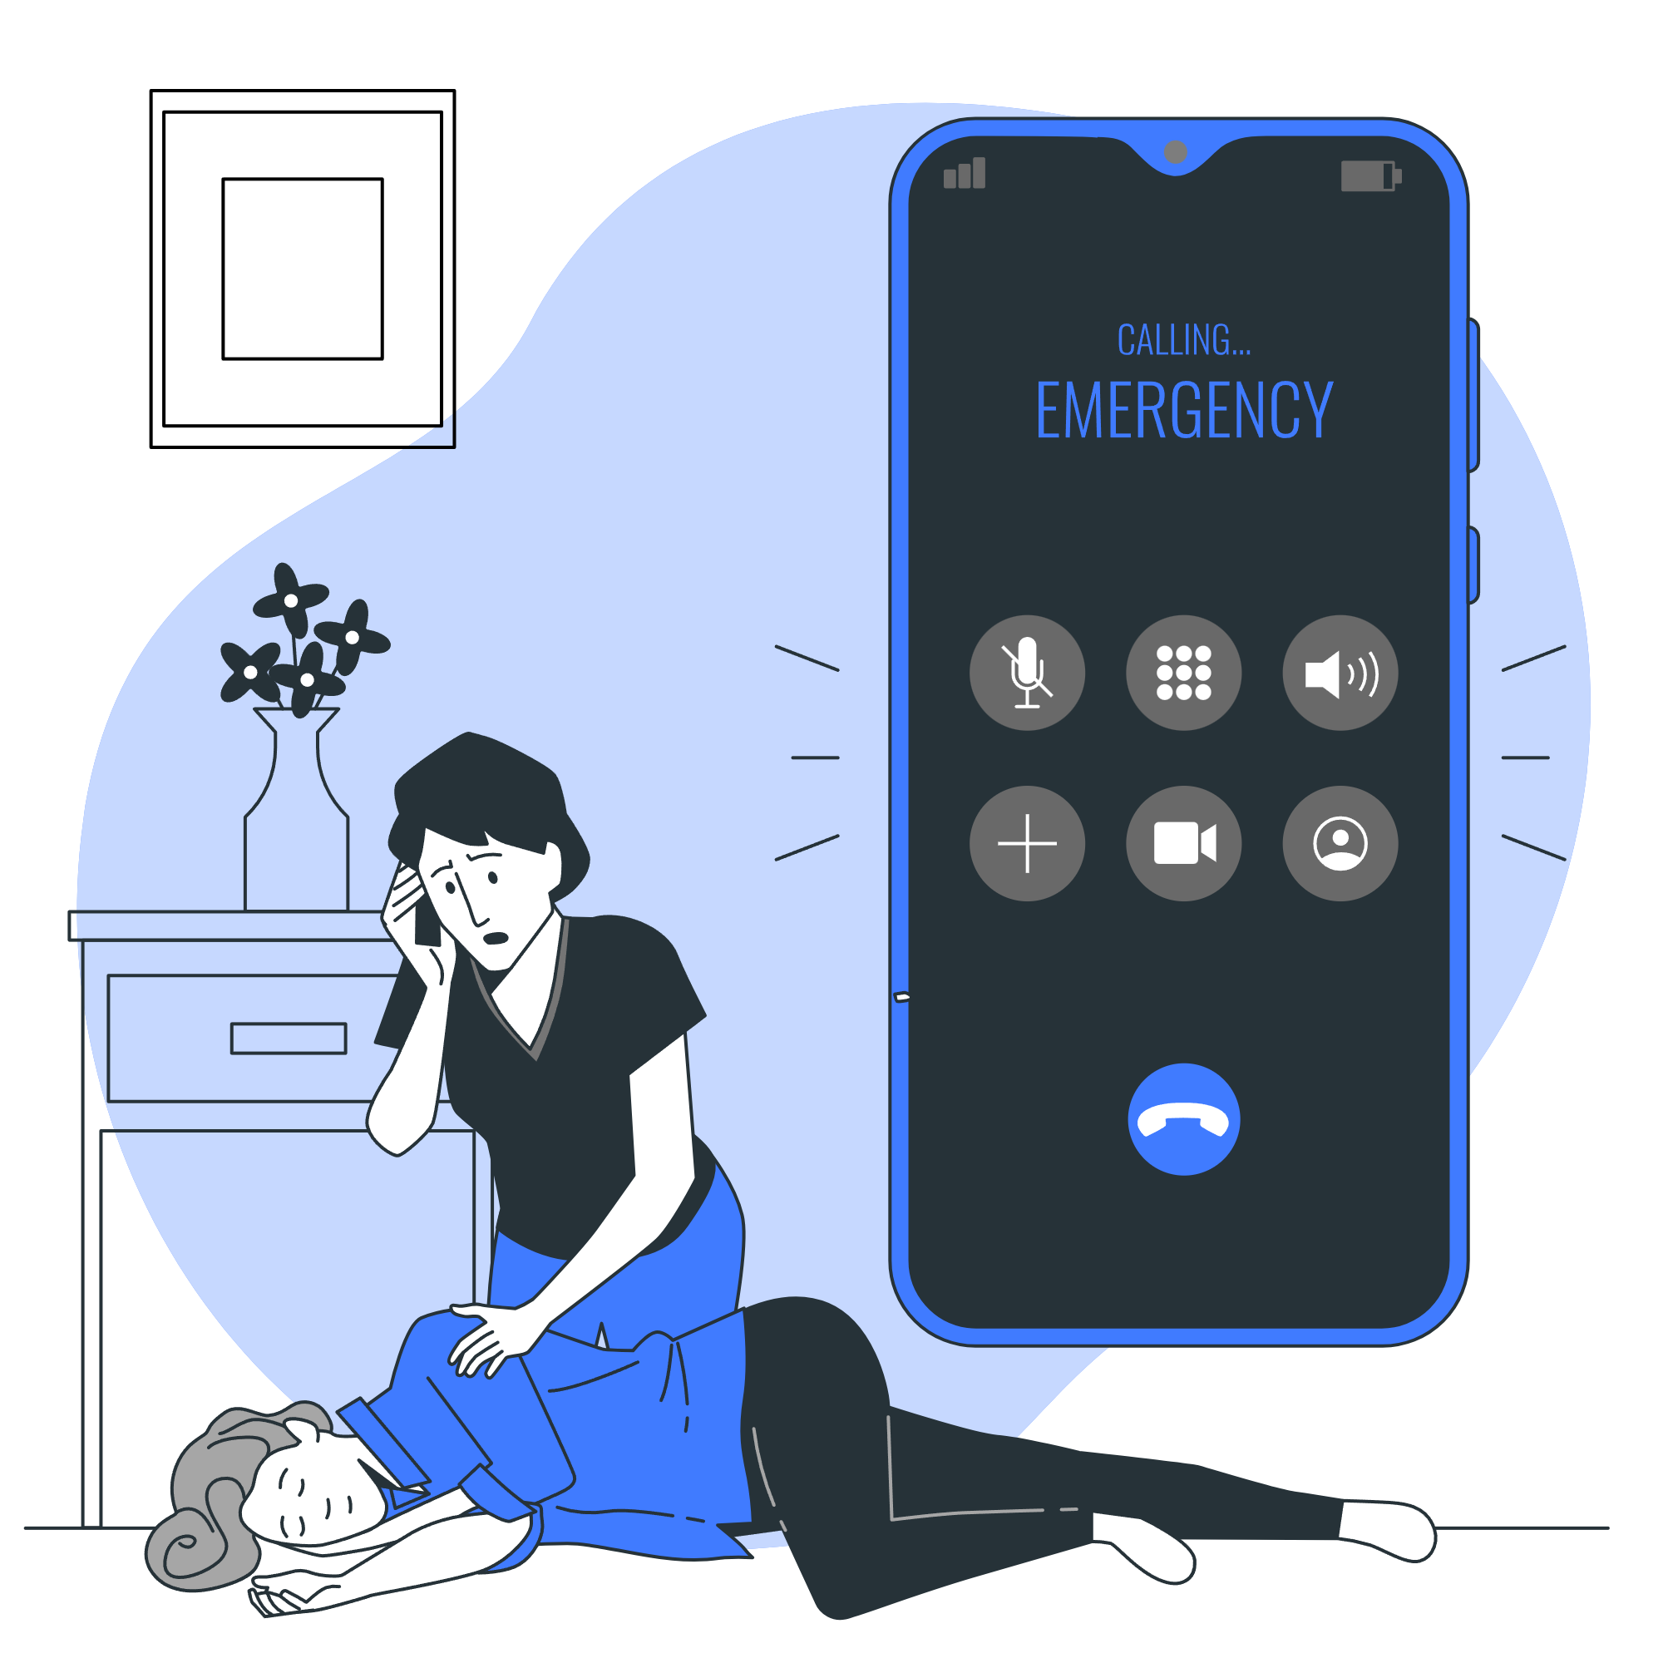
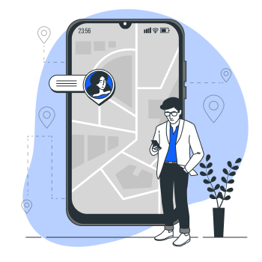
05
Solution Cont.
SOS Request
Emergency Contacts
Real time location
Caregivers can track the patient’s location in real time. Alerts are sent if the patient wanders into unsafe areas.
Patients can trigger an SOS request in case of an emergency. The system will instantly notify registered caregivers, allowing them to respond quickly and provide the necessary assistance.
A quick-access list of emergency contacts allows patients or caregivers to call for help instantly when needed.
12

Slide 15


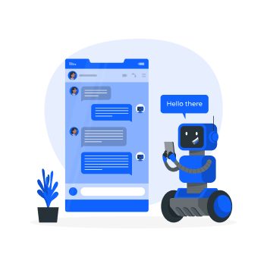
01
05
Solution Cont.
02
03
Safe Zone & Boundary Alerts
Community Support &
Educational Resources
AI Chat bot &
Face Recognition
06
The caregiver can define a geographical safe zone. If the patient wanders outside this area, an immediate alert is sent to caregivers, helping prevent disorientation or dangerous situations.
Caregivers can access a support network, share experiences, and find expert guidance. Educational resources provide insights on managing Alzheimer’s, improving care, and enhancing daily life.
The AI chatbot assists caregivers with guidance, and quick answers to common concerns. Face recognition helps patients identify family members and caregivers, reducing confusion and enhancing social interactions.
Stakeholders
07
13
08
09

Slide 16
06
Stakeholders
01
02
03
04
05
07
08
21
09

Slide 17
01
06
Stakeholders
02
The project scope specify the functionality of each user in our app:-
Admin:
Add educational resources to the community.
Monitor overall system usage.
Send announcements and updates for the users
Caregiver:
Monitor the patient’s real-time location.
Set medical and appointments reminders.
Control safe zones for the patient
Interact with a chatbot to receive caregiving tips, support.
03
05
07
Patient:
Receive medication reminders
Access memory training exercises
Use face recognition to identify people
Trigger emergency actions to alert caregivers.
Architecture & Technologies
08
15
09

Slide 18
07
Architecture & Technologies
01
02
03
04
05
06
08
14
09

Slide 19


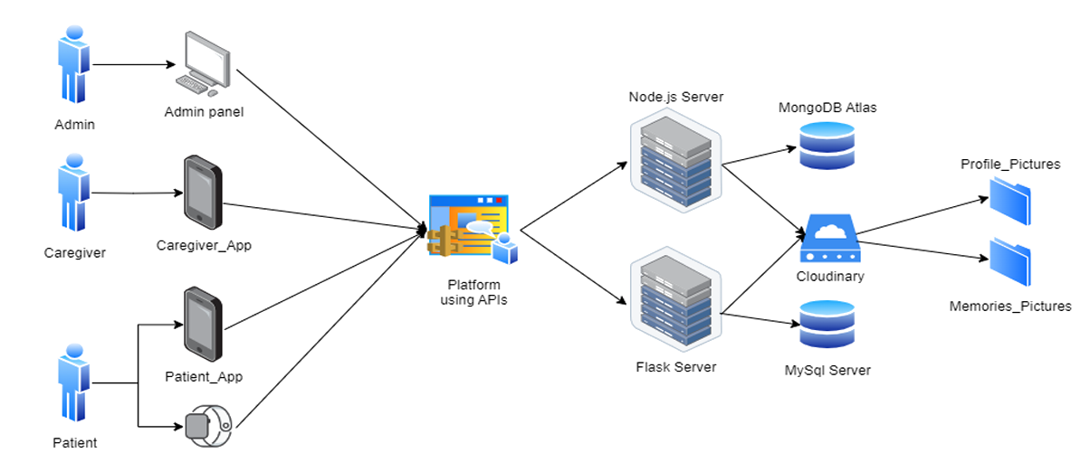

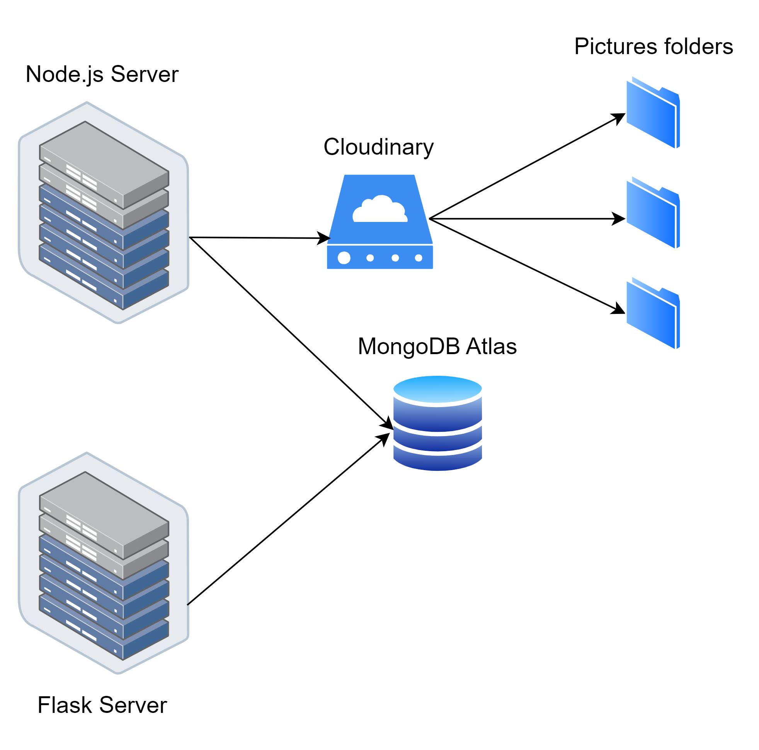





01
07
Architecture & Technologies
02
03
05
07
Stakeholders
08
09

Slide 20
08
ML & Location
01
02
03
04
05
06
07
21
09

Slide 21
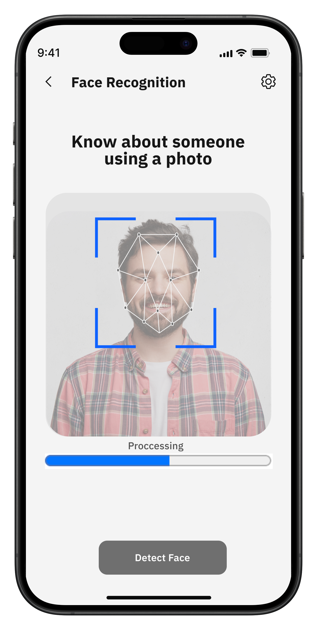
08
Machine Learning
Our feature: Face recognition
Used Algorithm: Supervised machine learning technique training on custom photos for each patient.
Output: Details about the recognized person.
Benefits:
Real-Time Updates.
Personalized Assistance
Accurate Identification.
22

Slide 22
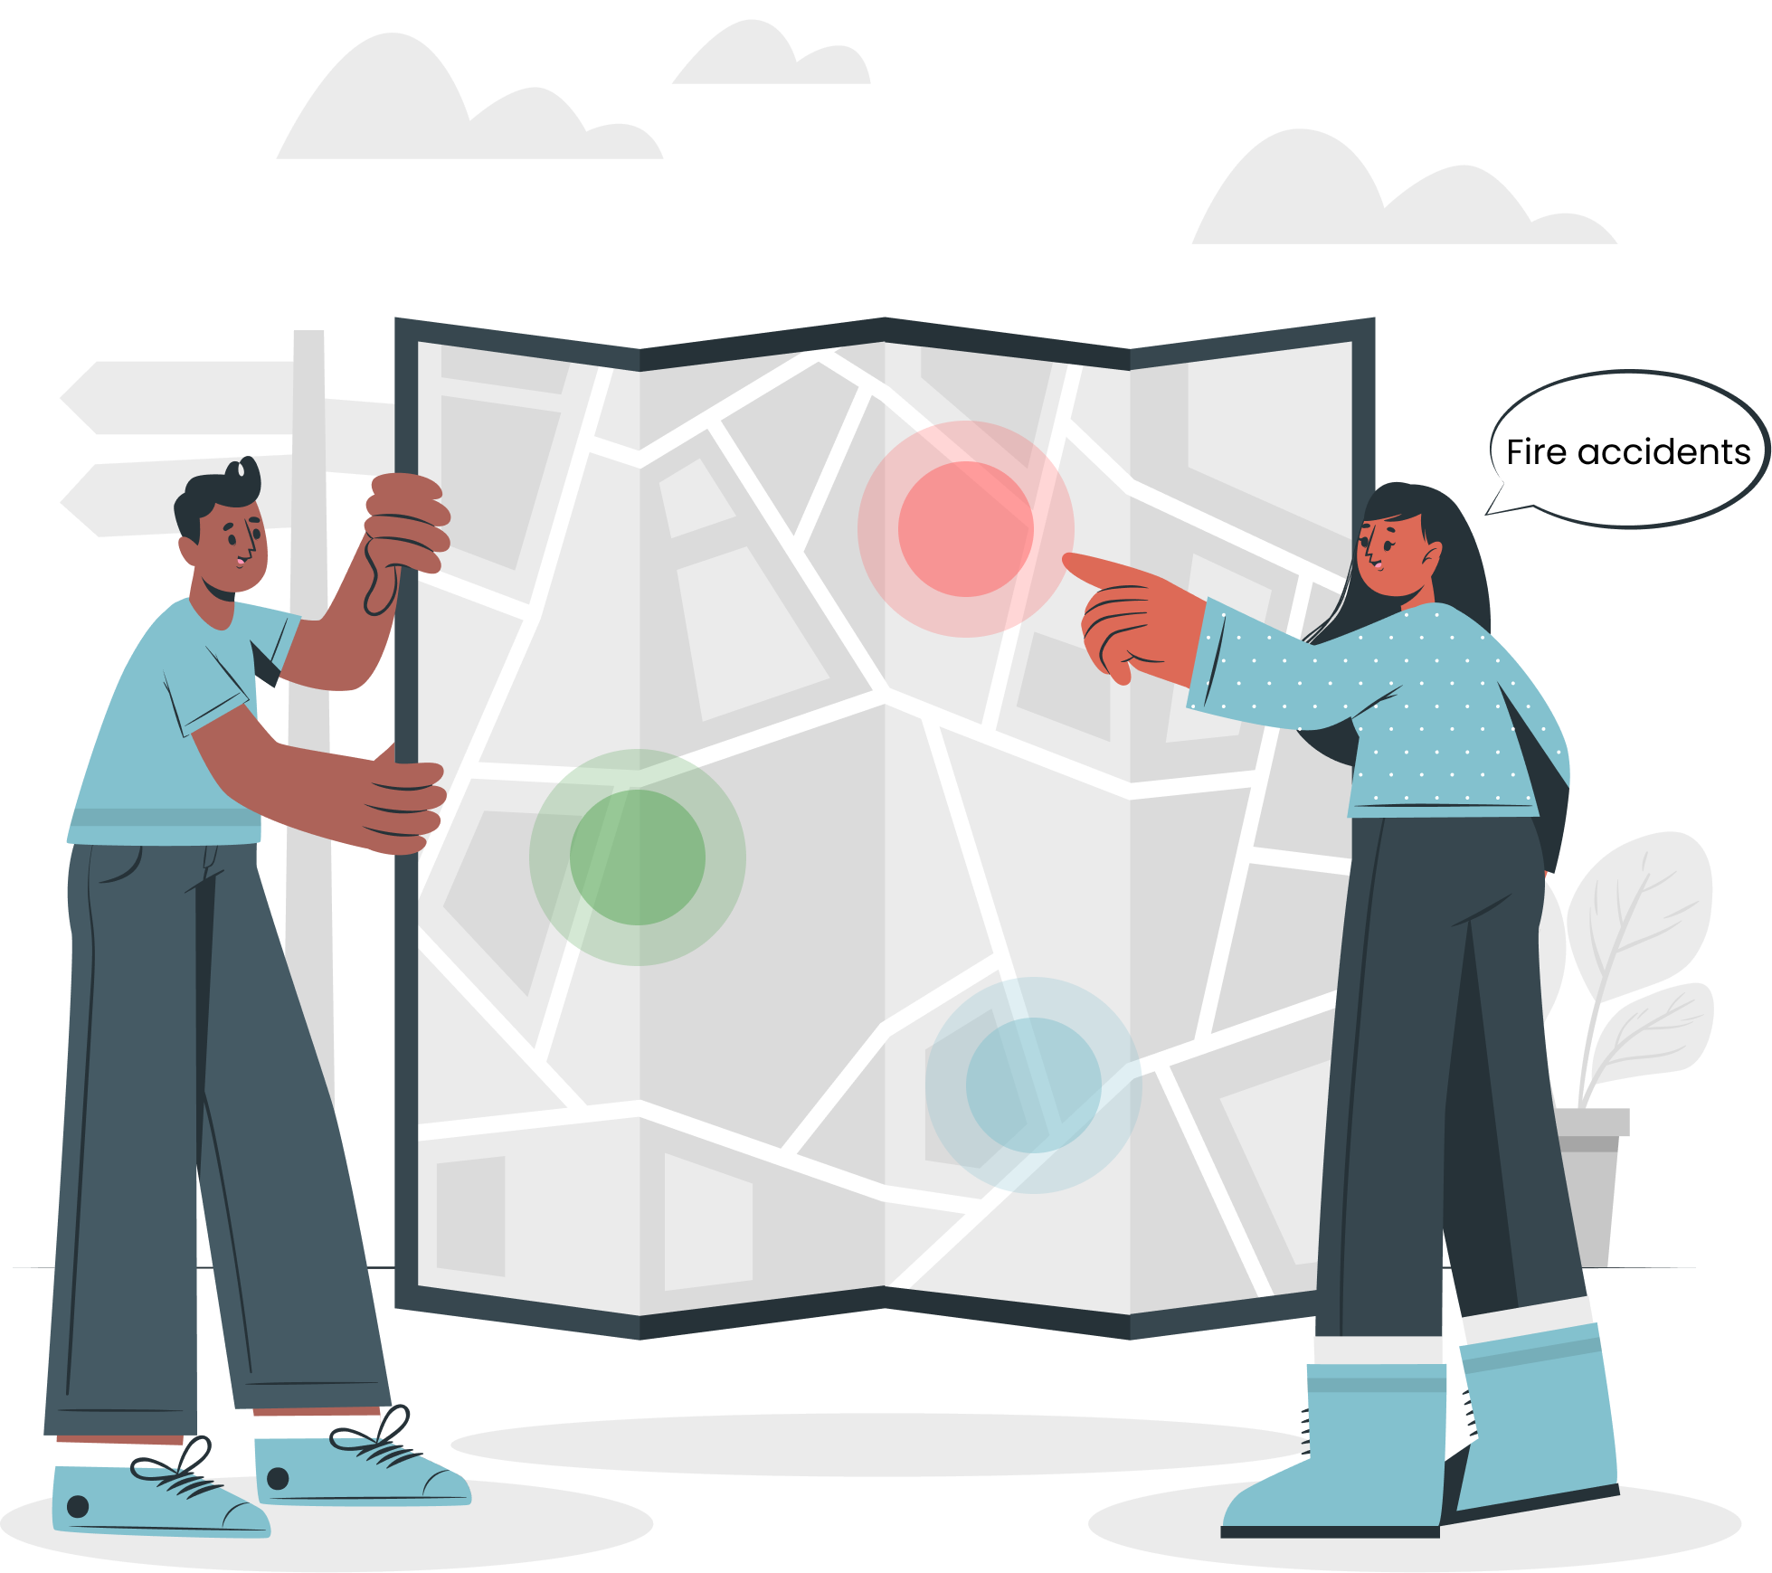
08
Location System
01
02
Our feature: Location tracking & Safe zone boundaries
Used Algorithm: point in circle (PIC)
Used technologies:
Google maps APIs
Socket.io
Output: Google maps
Benefits:
Real-Time tracking.
Safe zone breach notification.
03
04
05
06
08
23
09
Prototype

Slide 23
09
Prototype
01
02
03
04
05
06
07
24
08

Slide 24
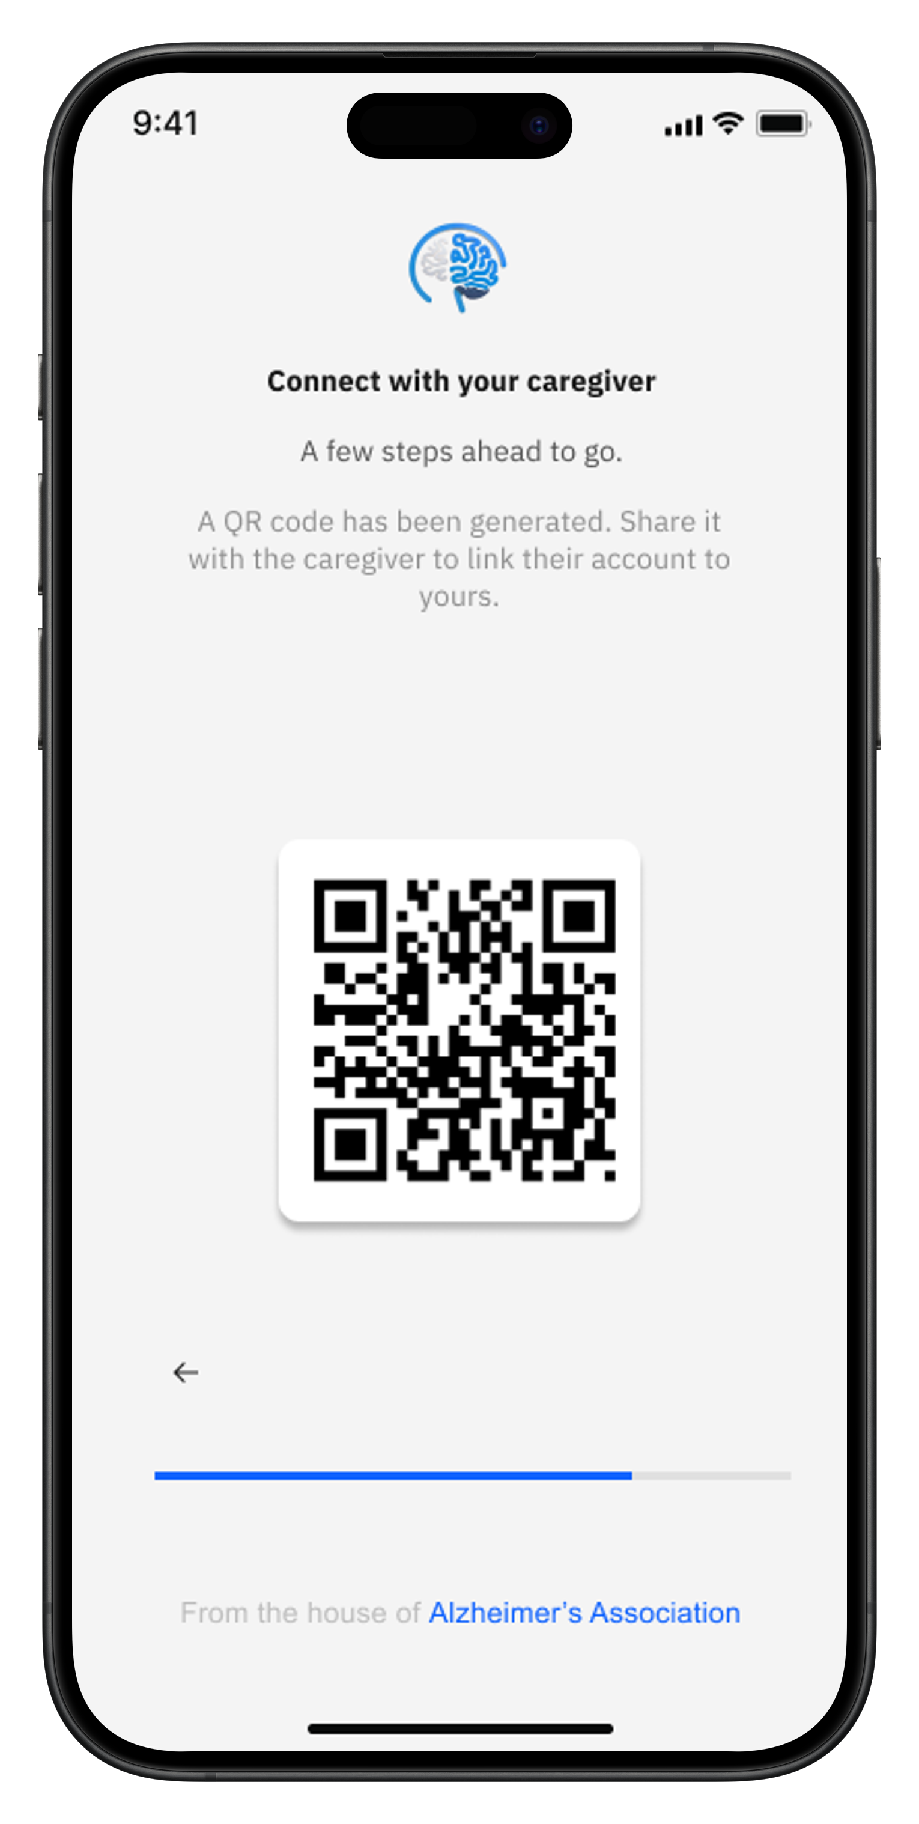
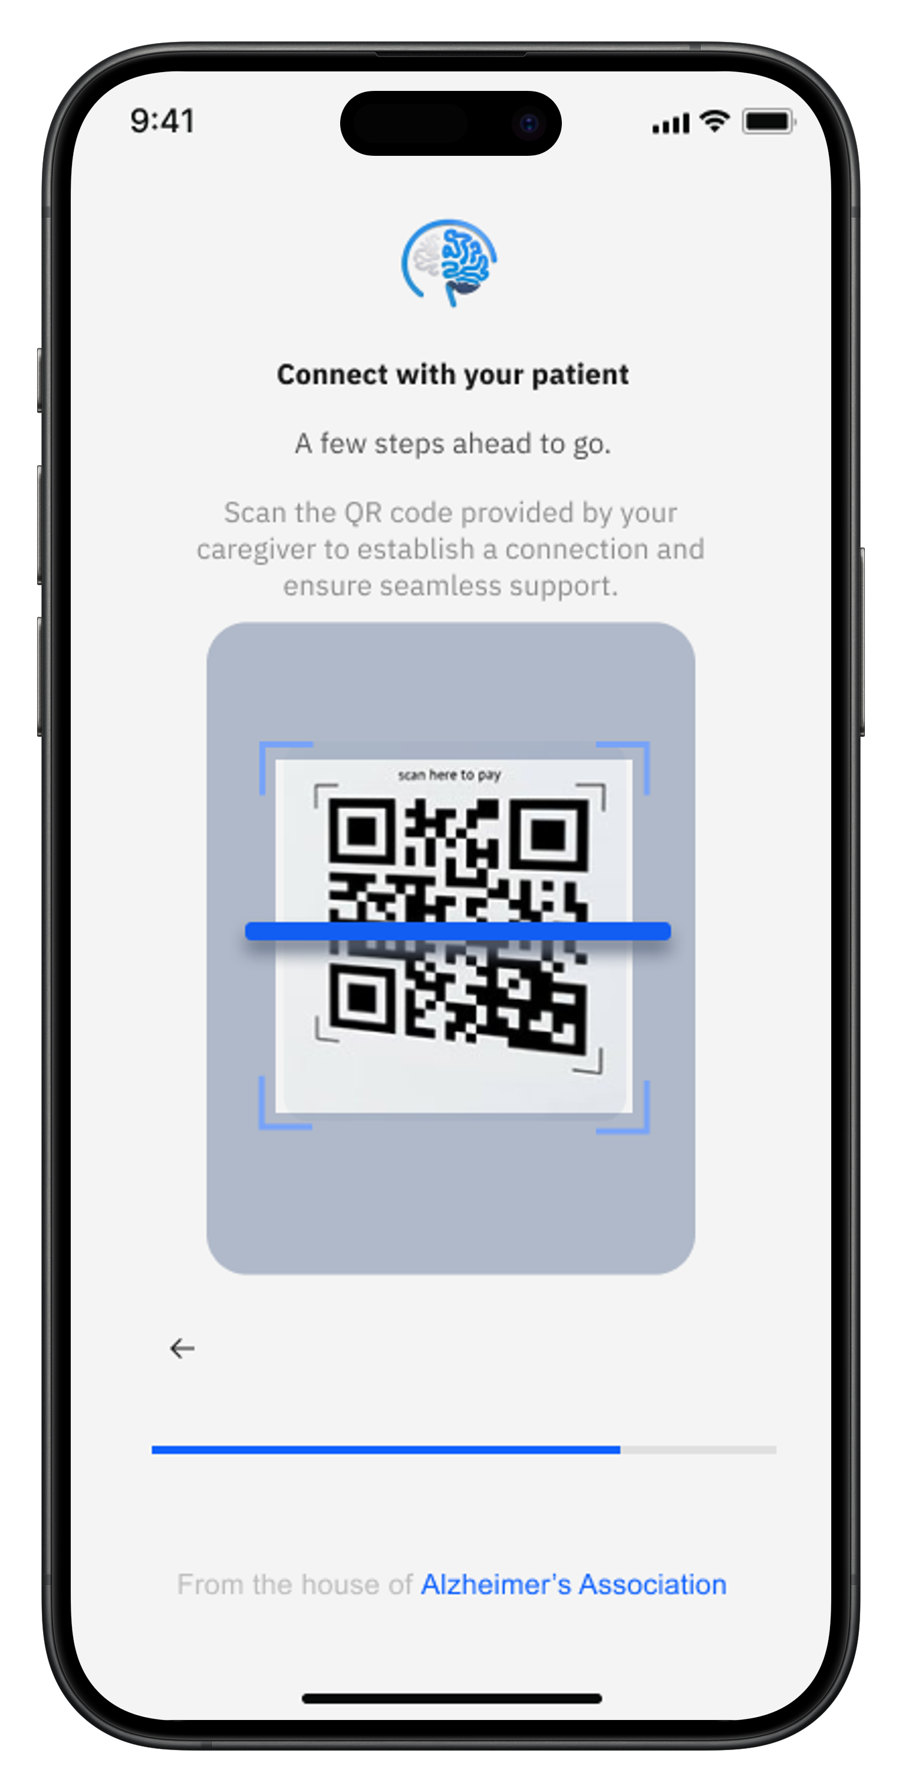
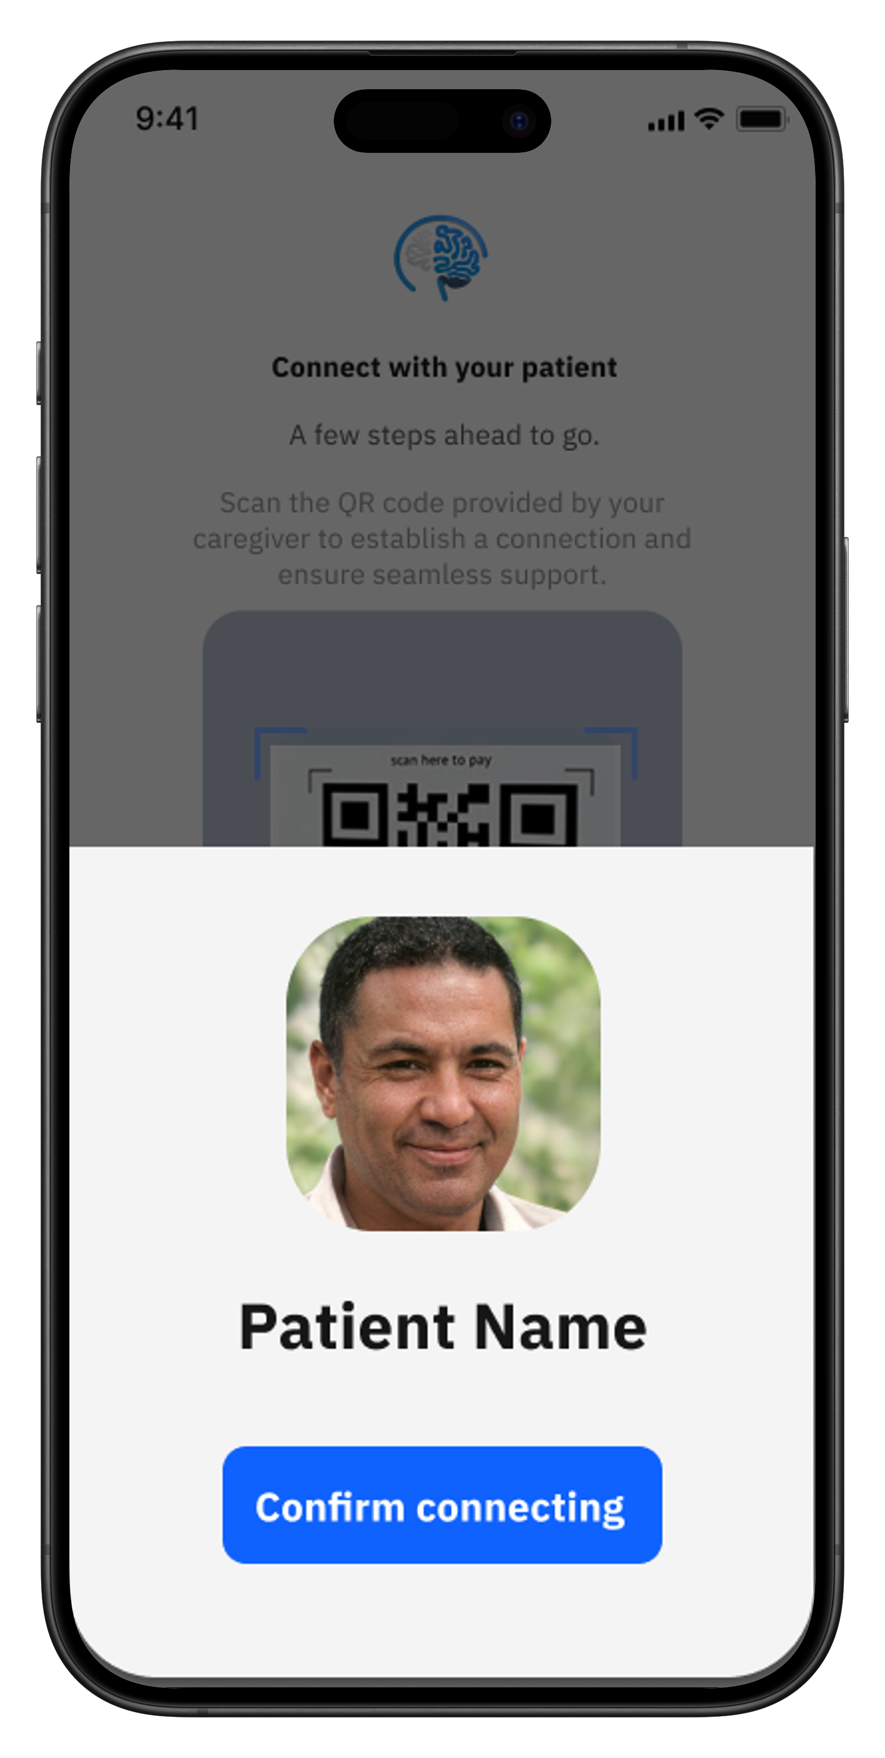
Linking Patient with caregiver
Patient App
Caregiver App
25

Slide 25
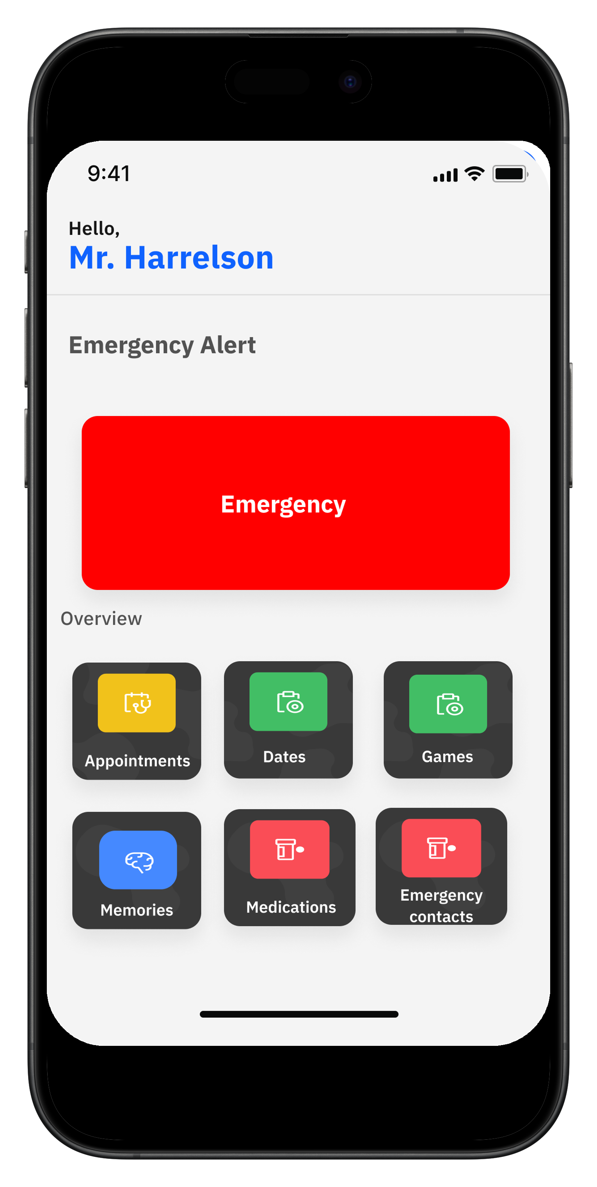
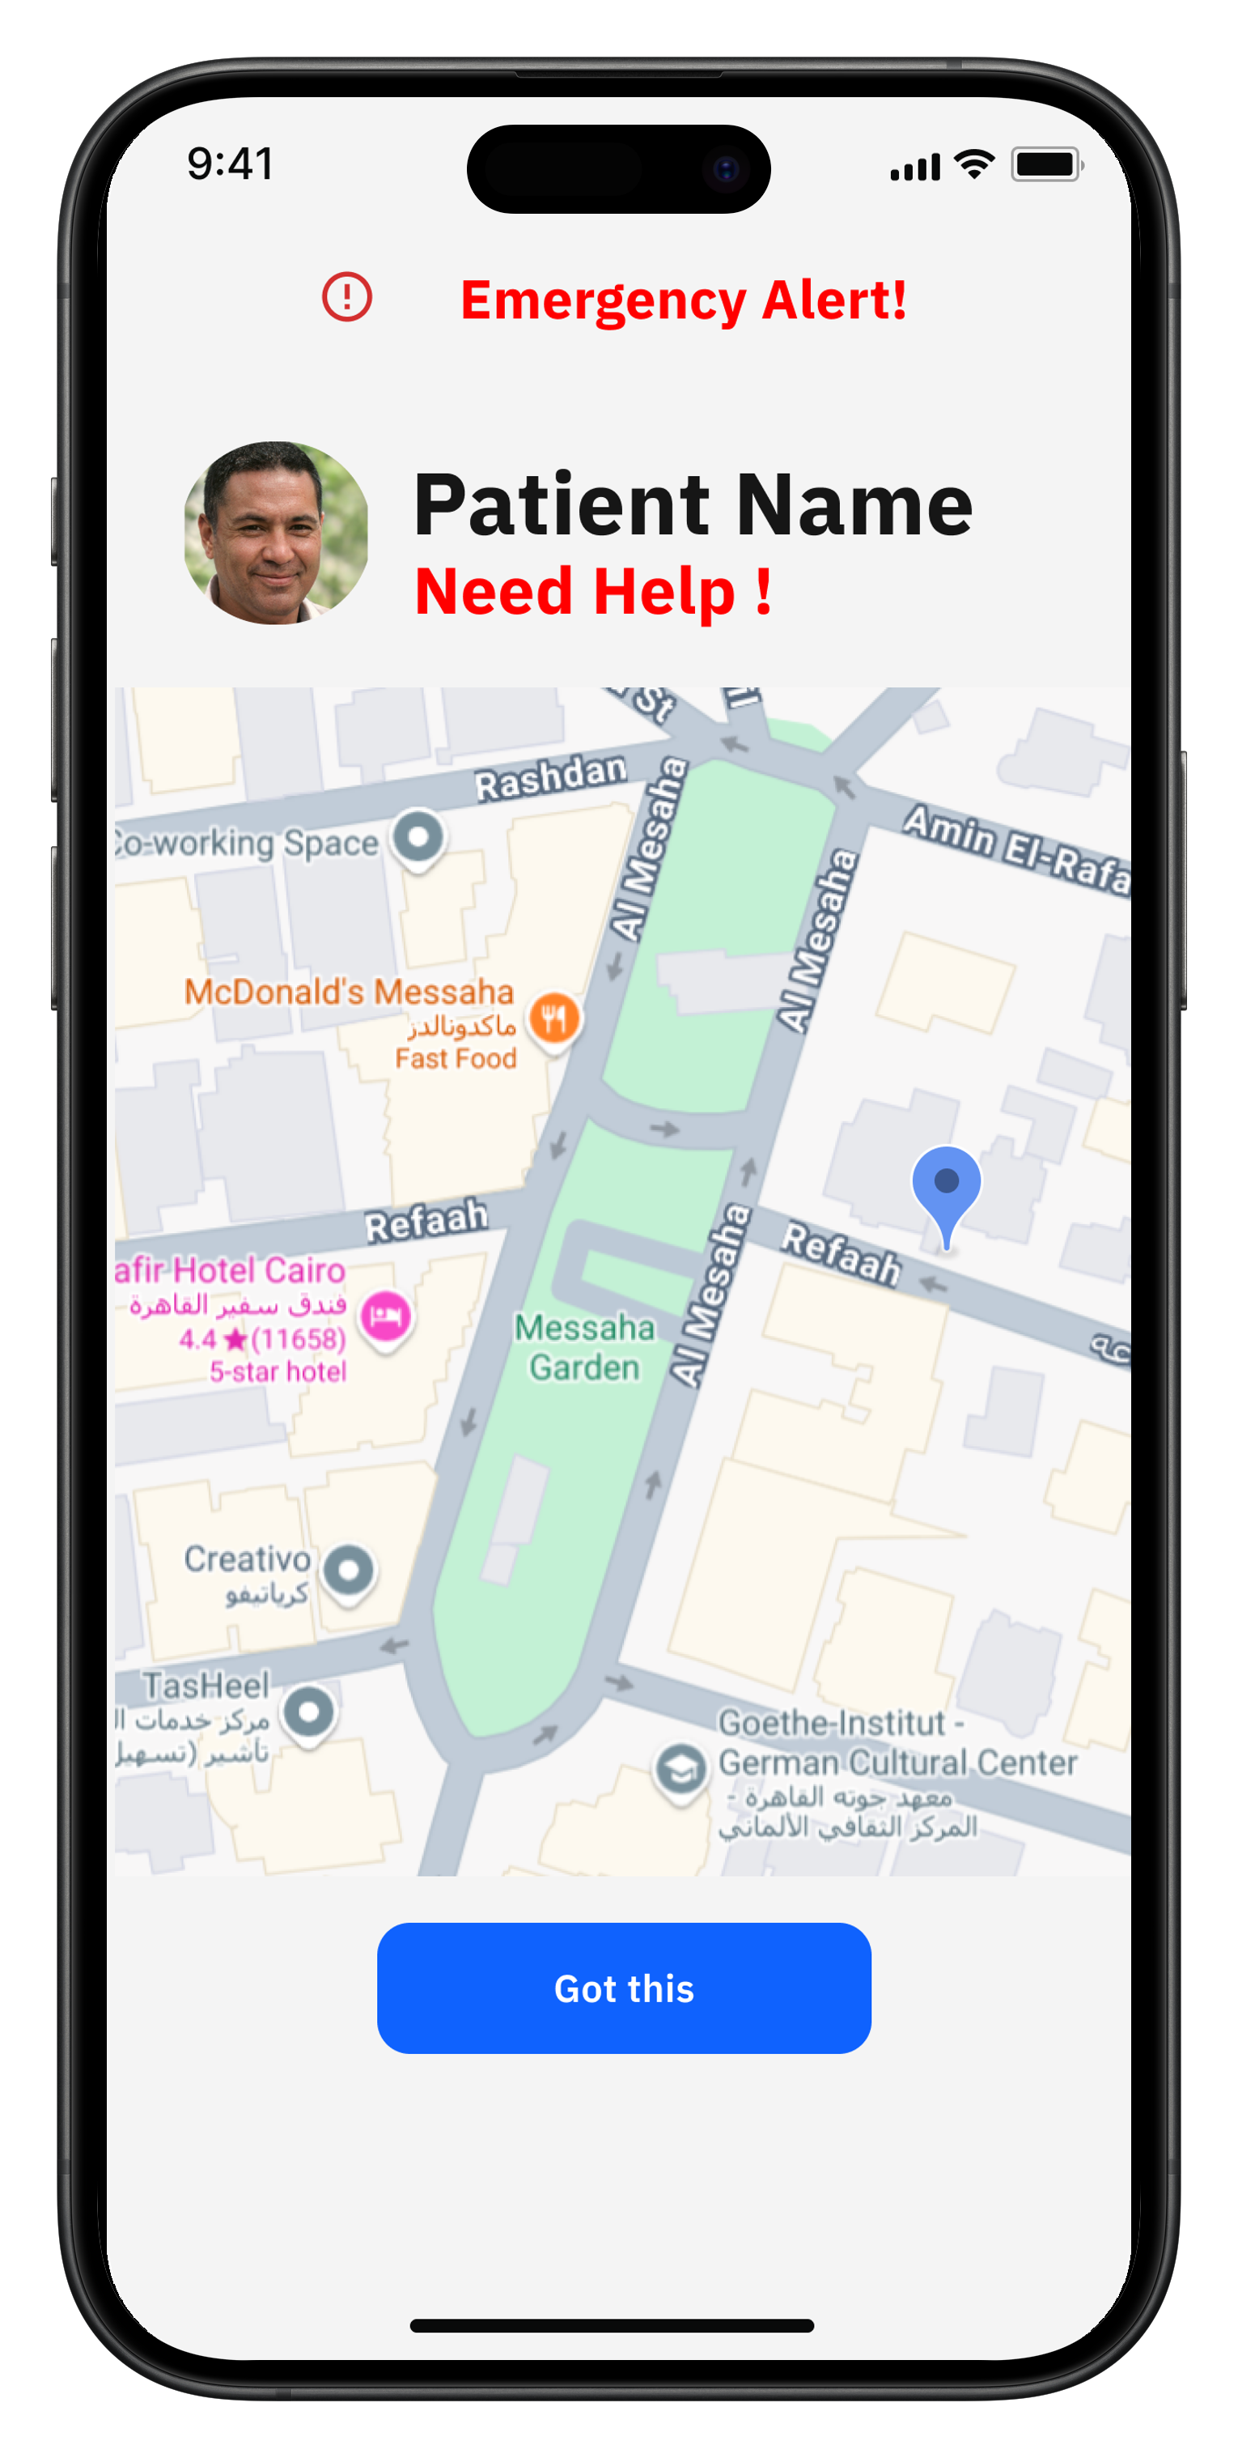
Emergency Request (SOS)
Patient App
Caregiver App
26

Slide 26
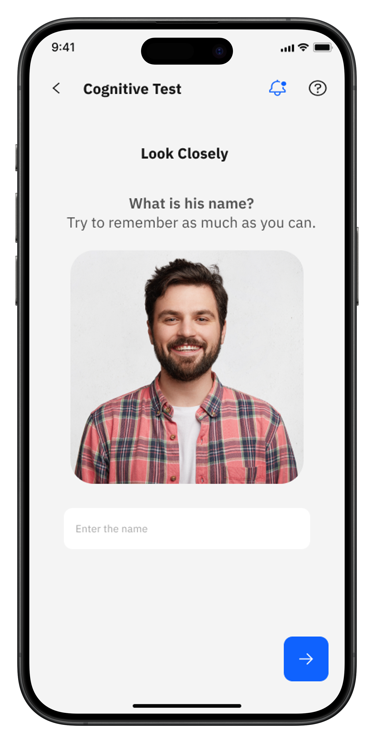

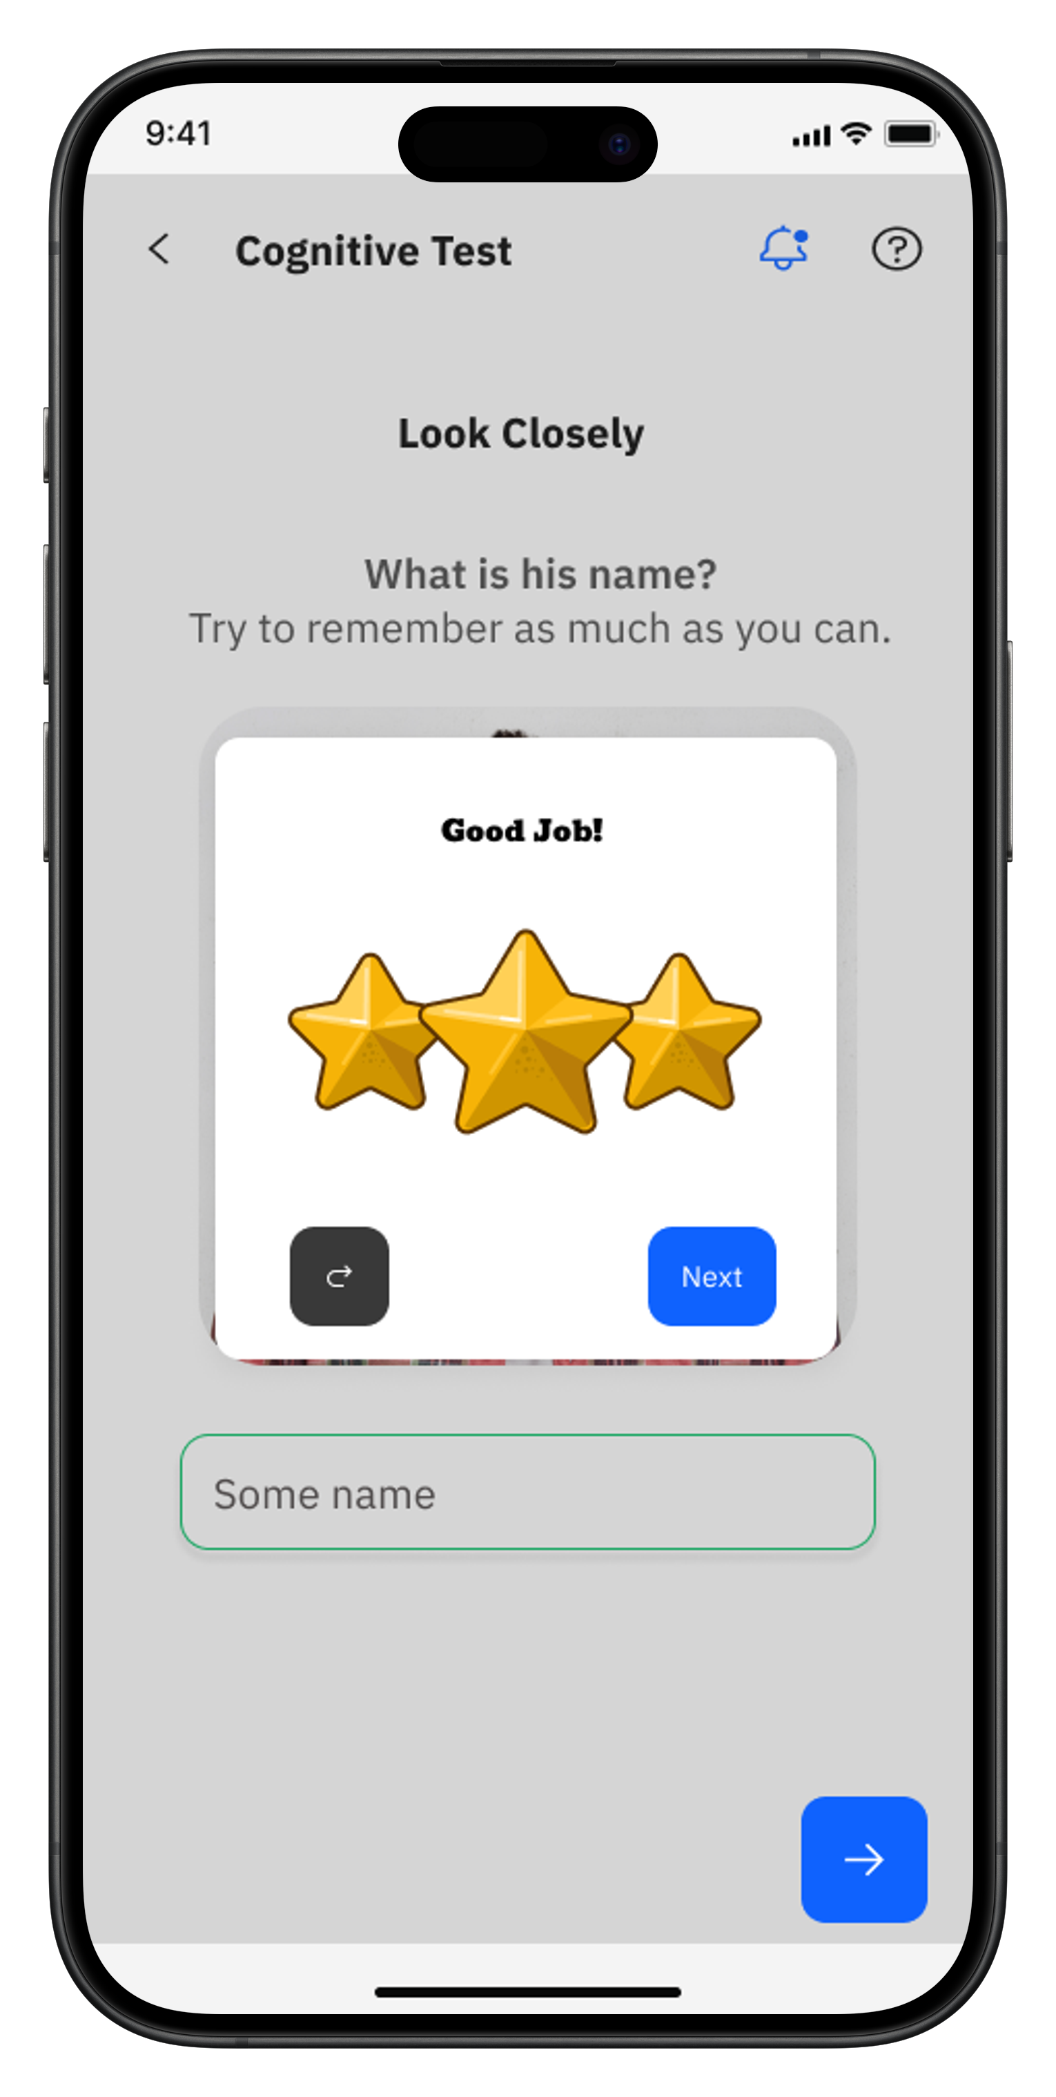
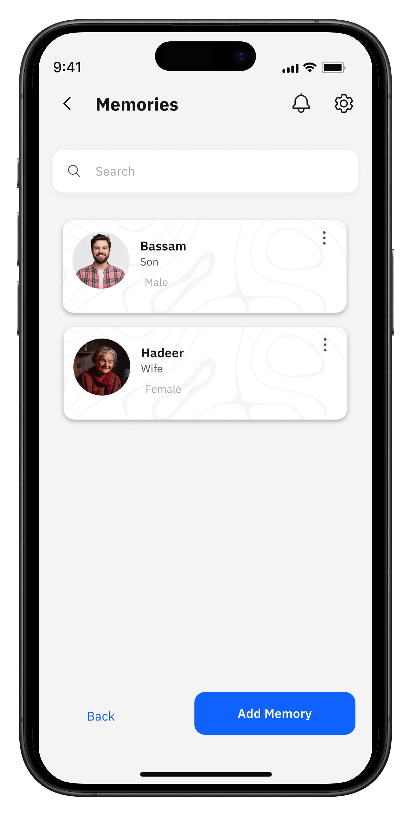
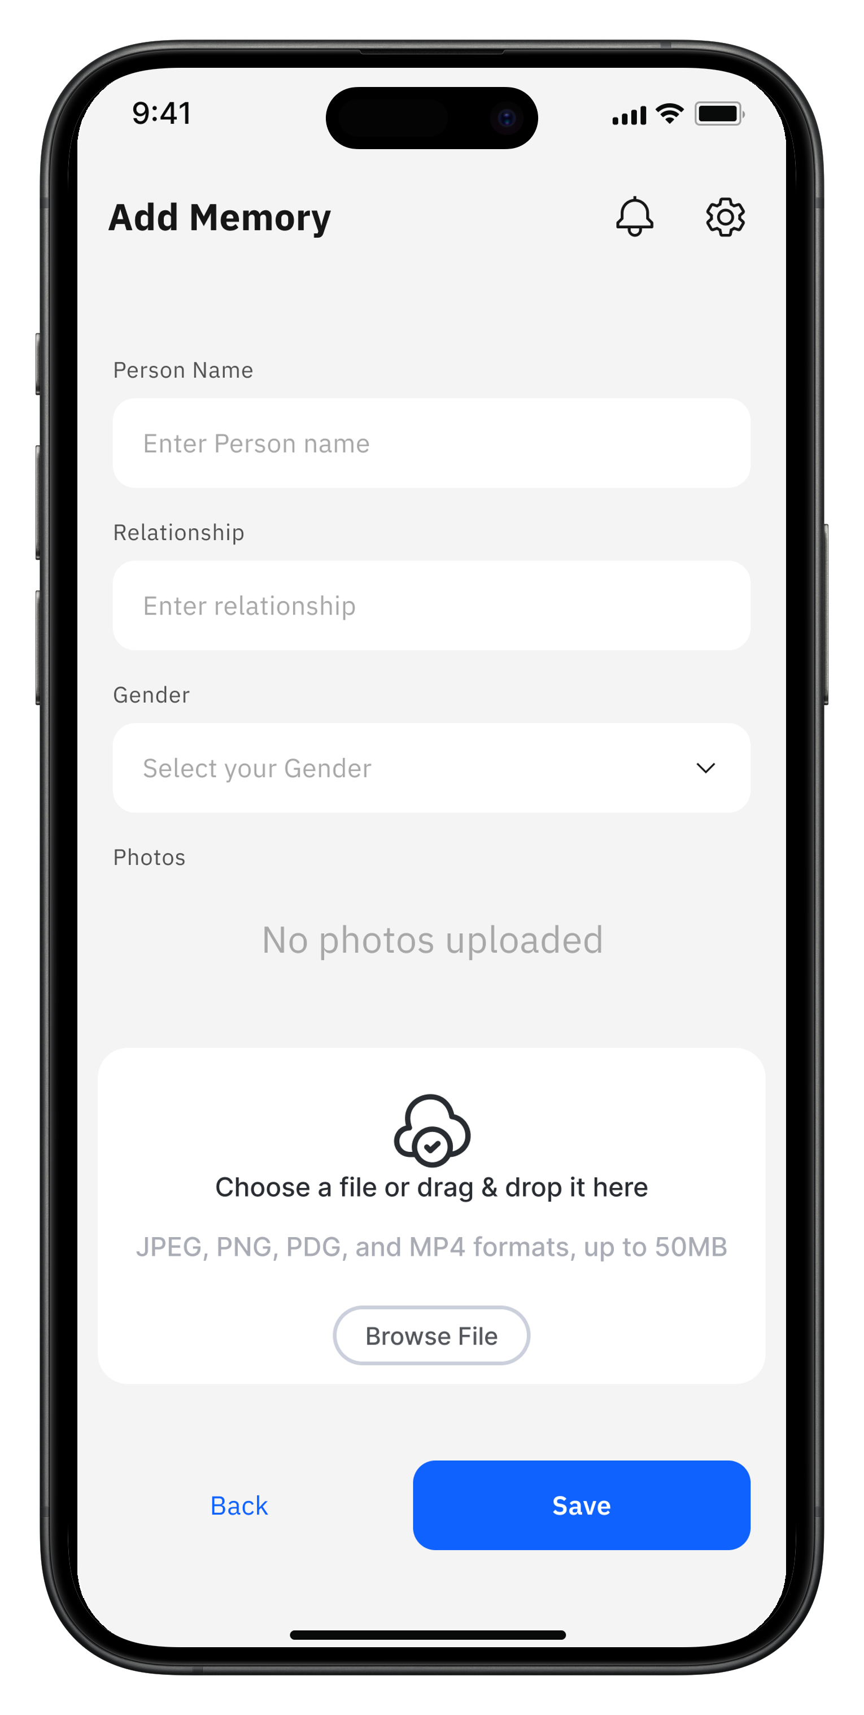
Memory Test
Patient App
Caregiver App
27

Slide 27
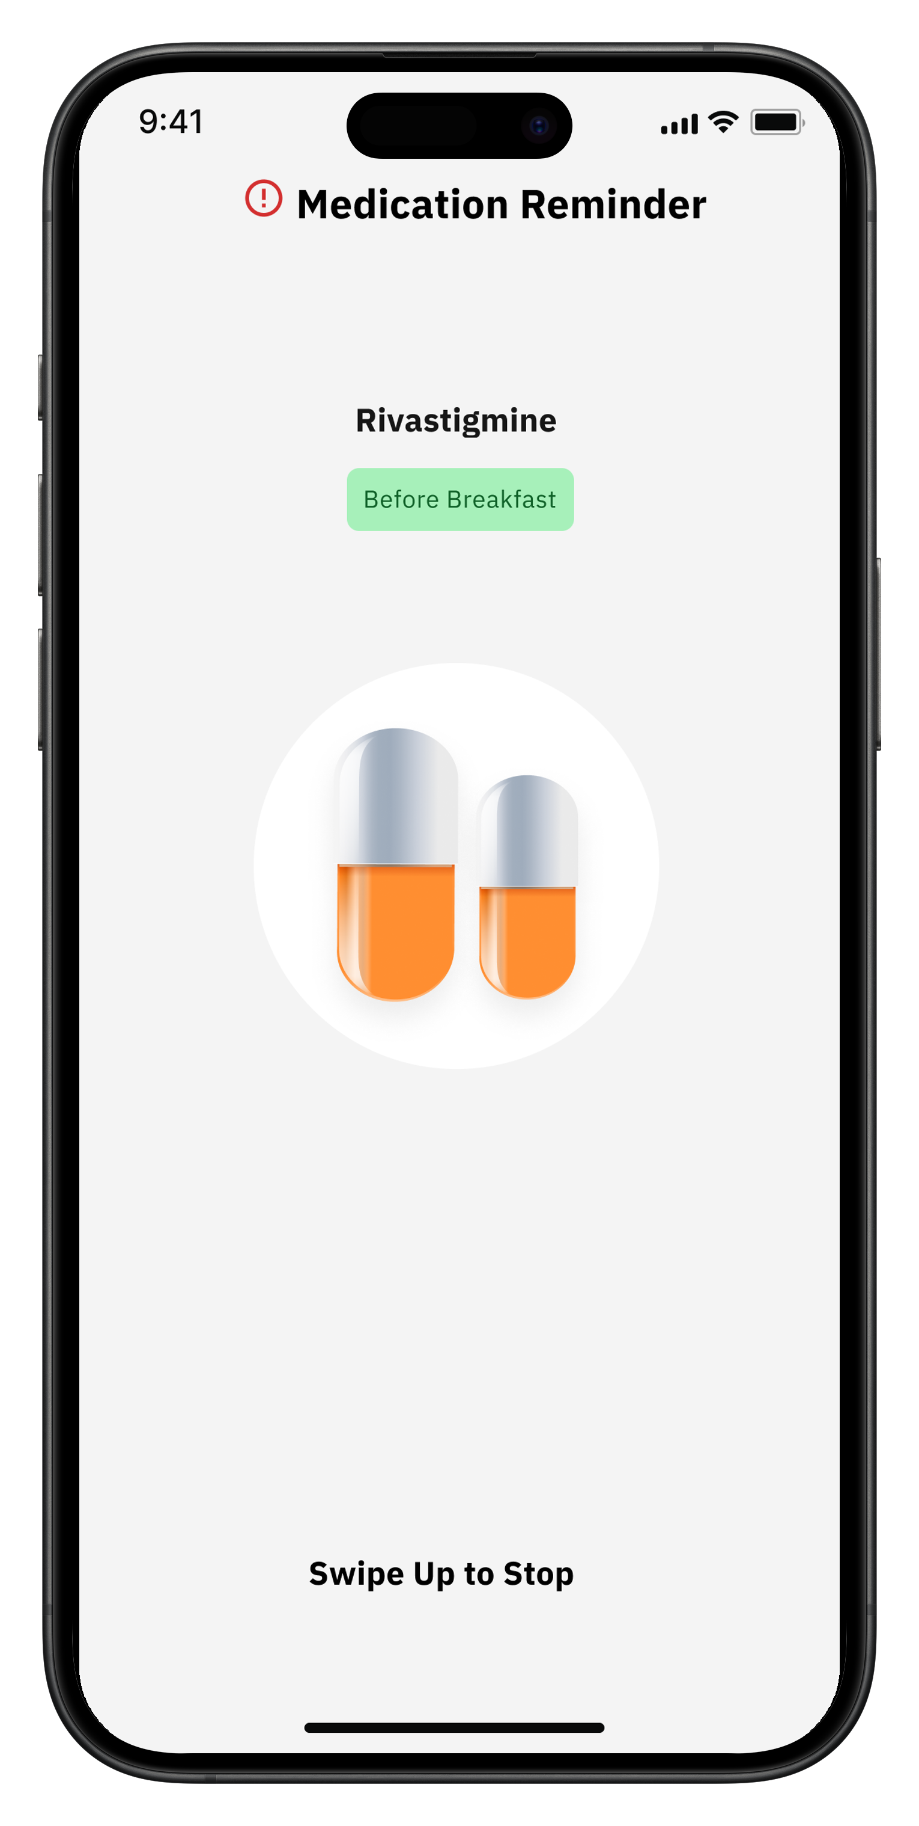
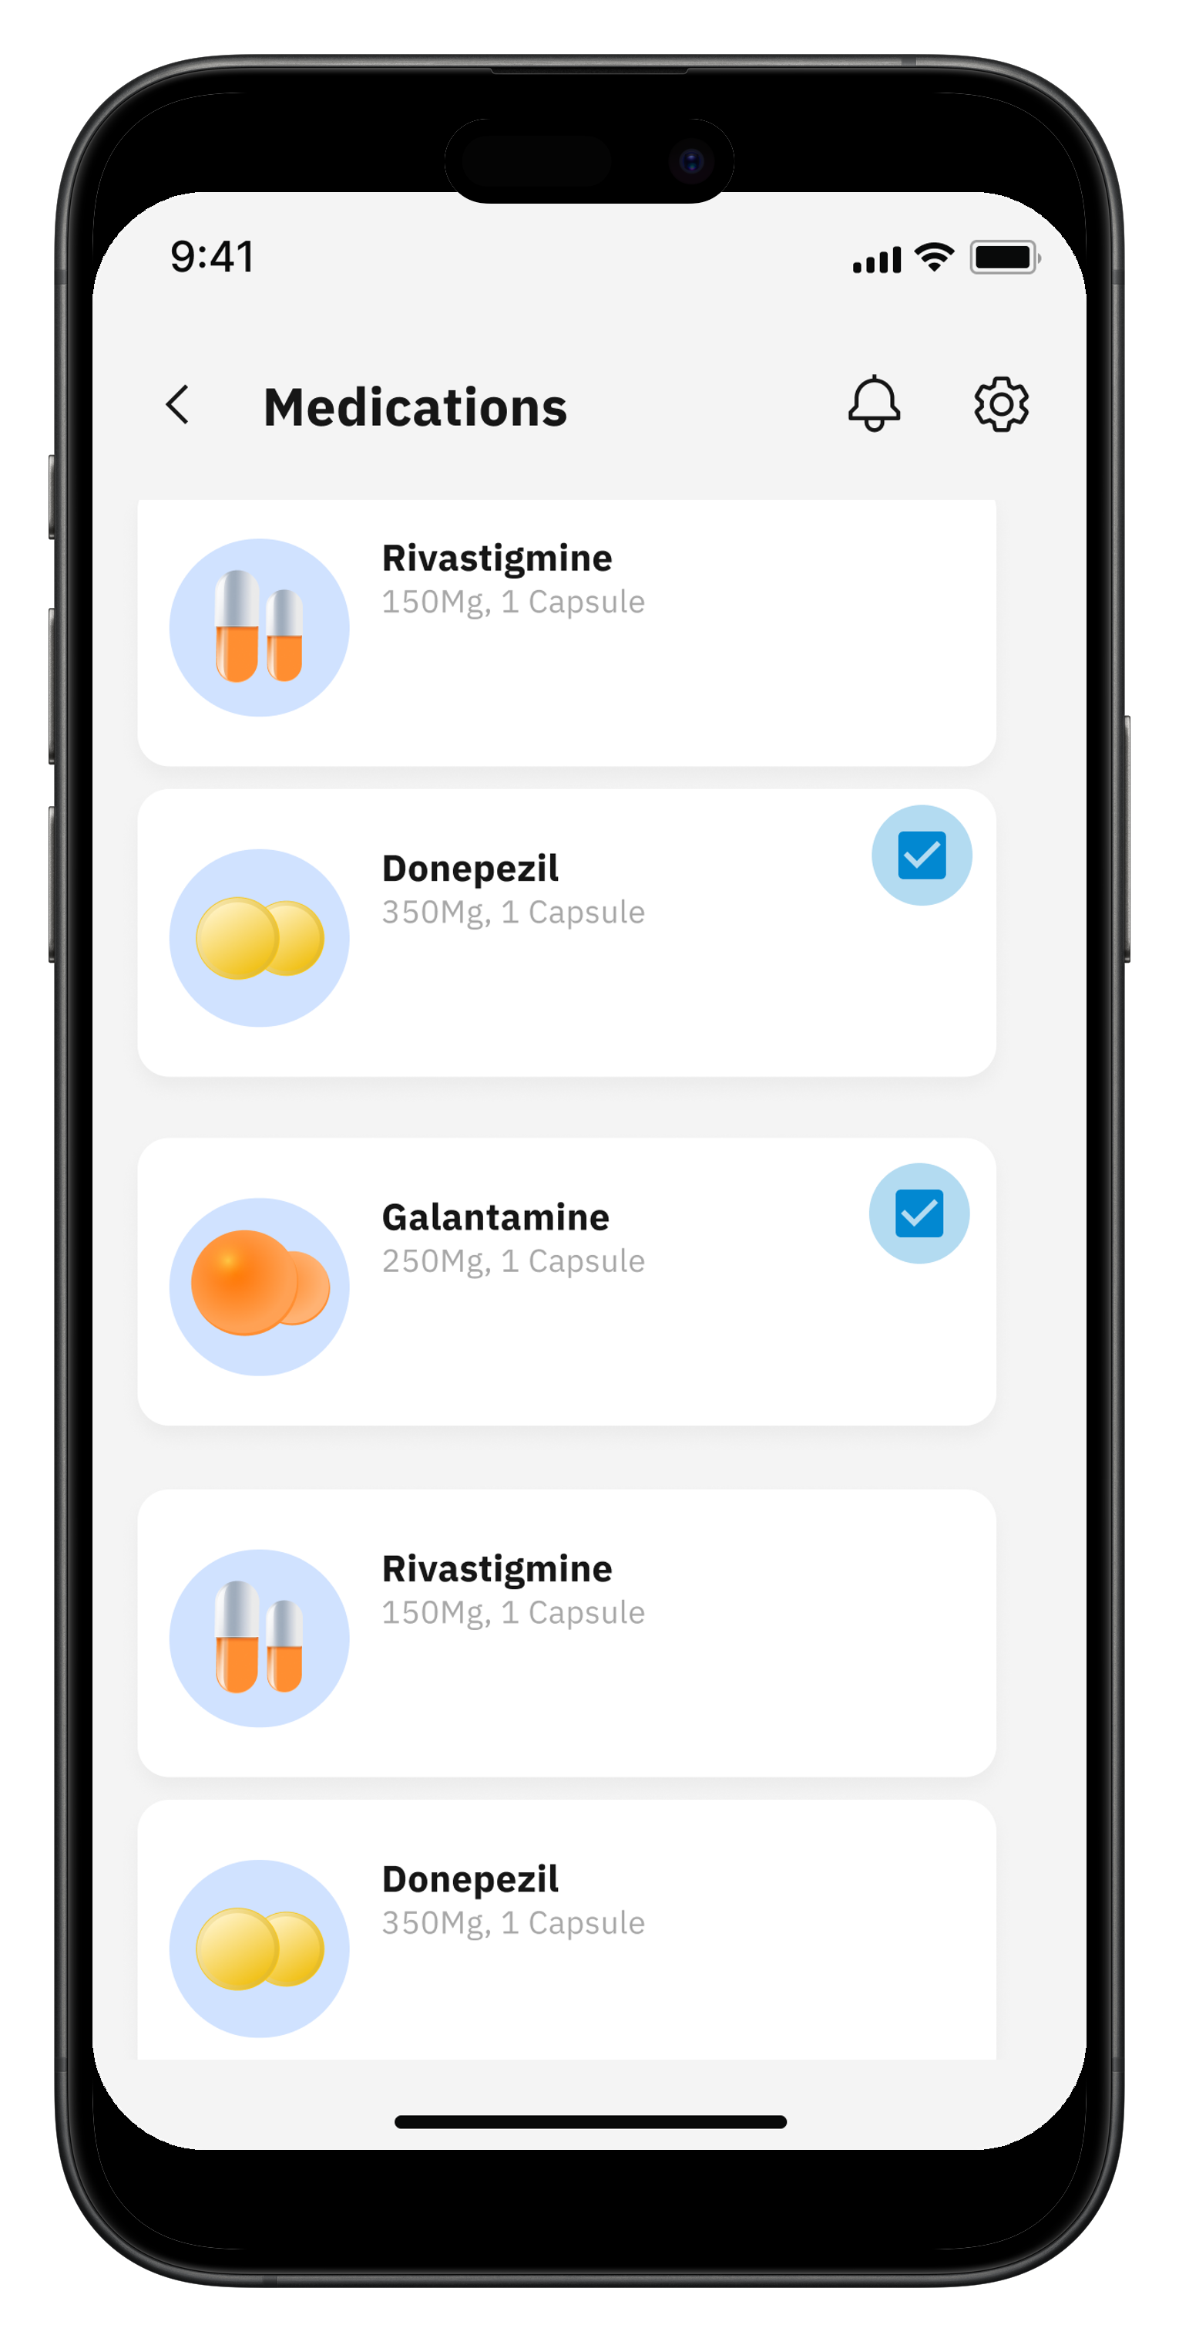
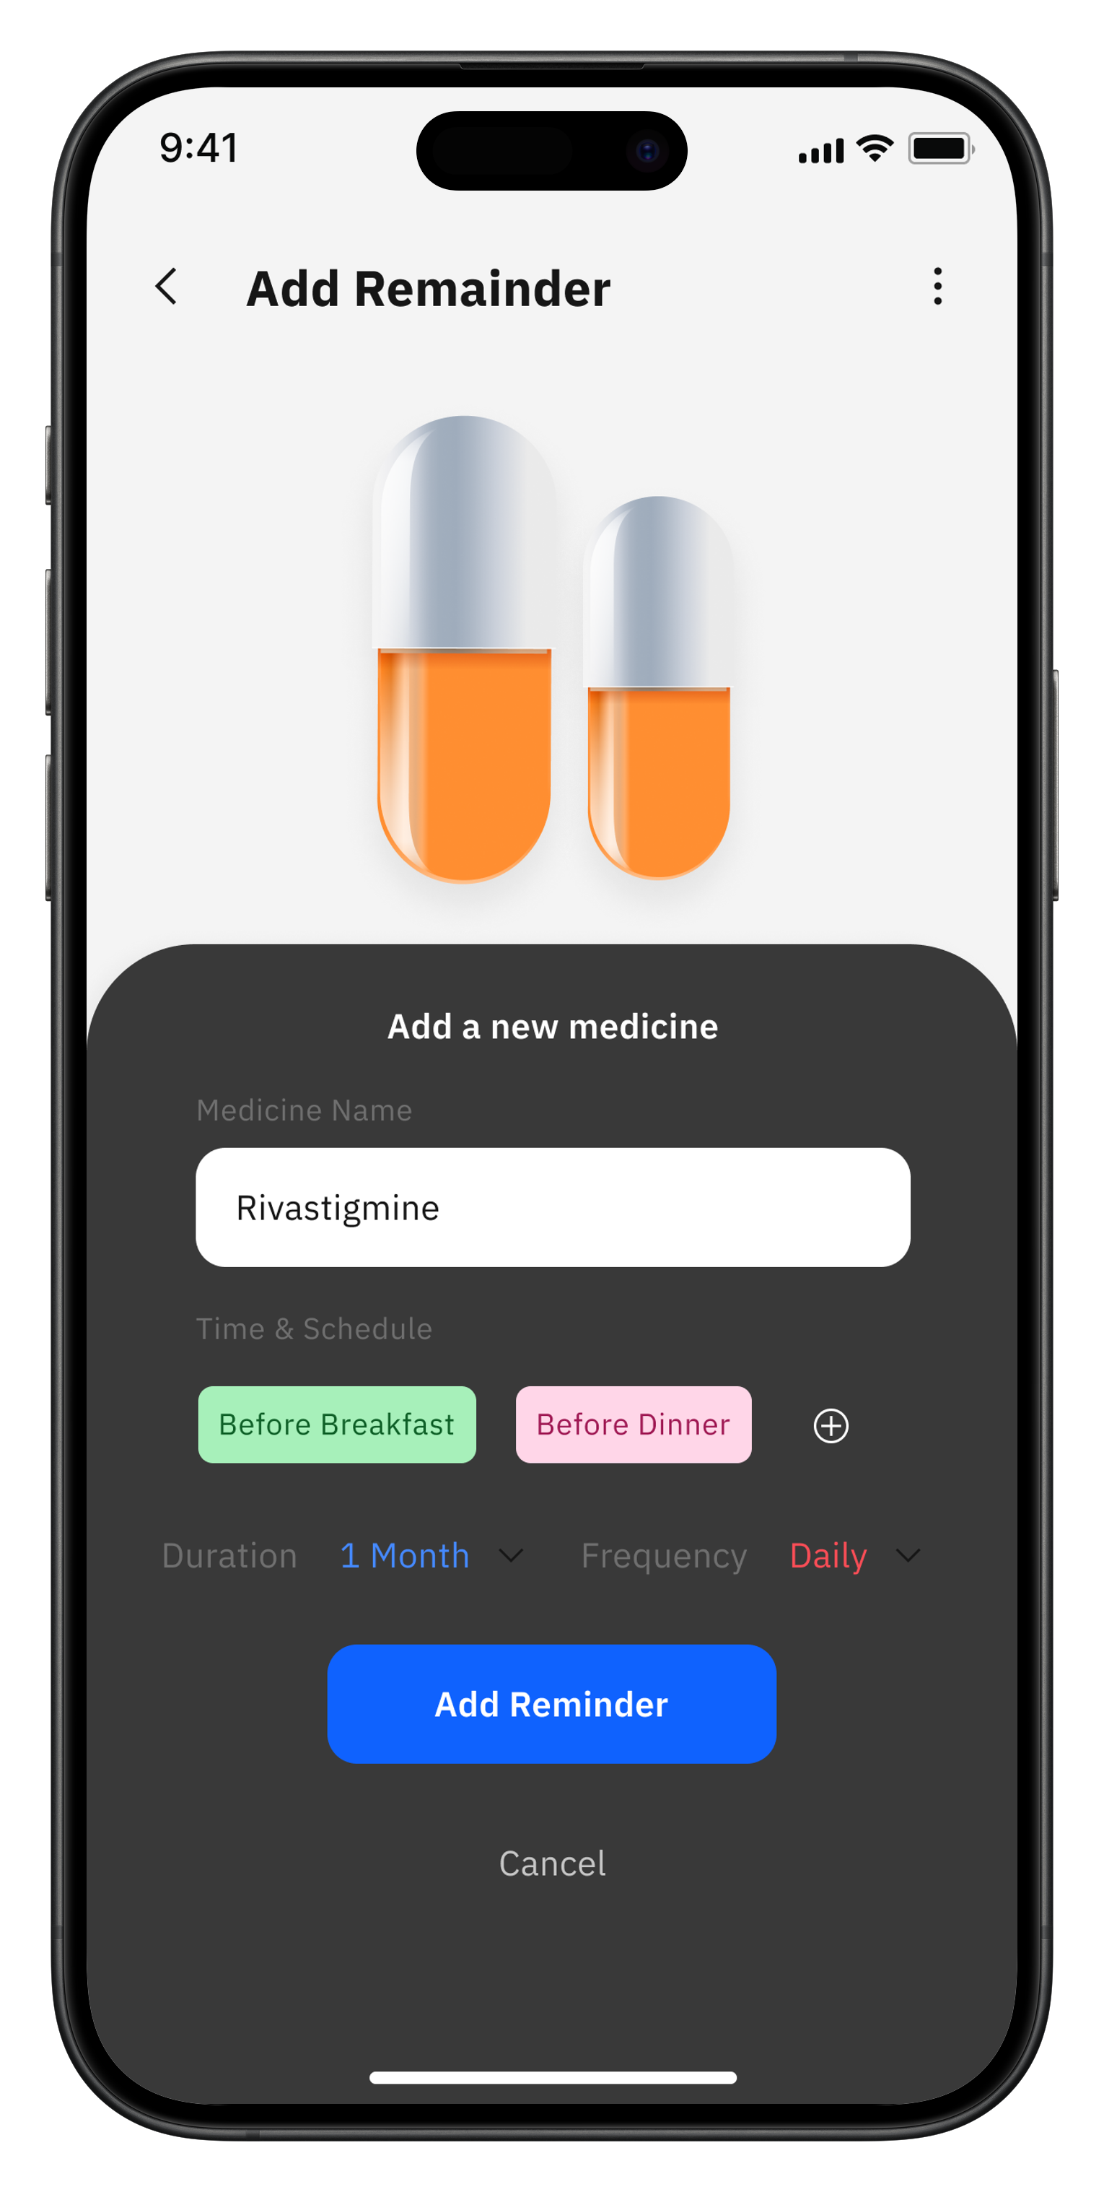
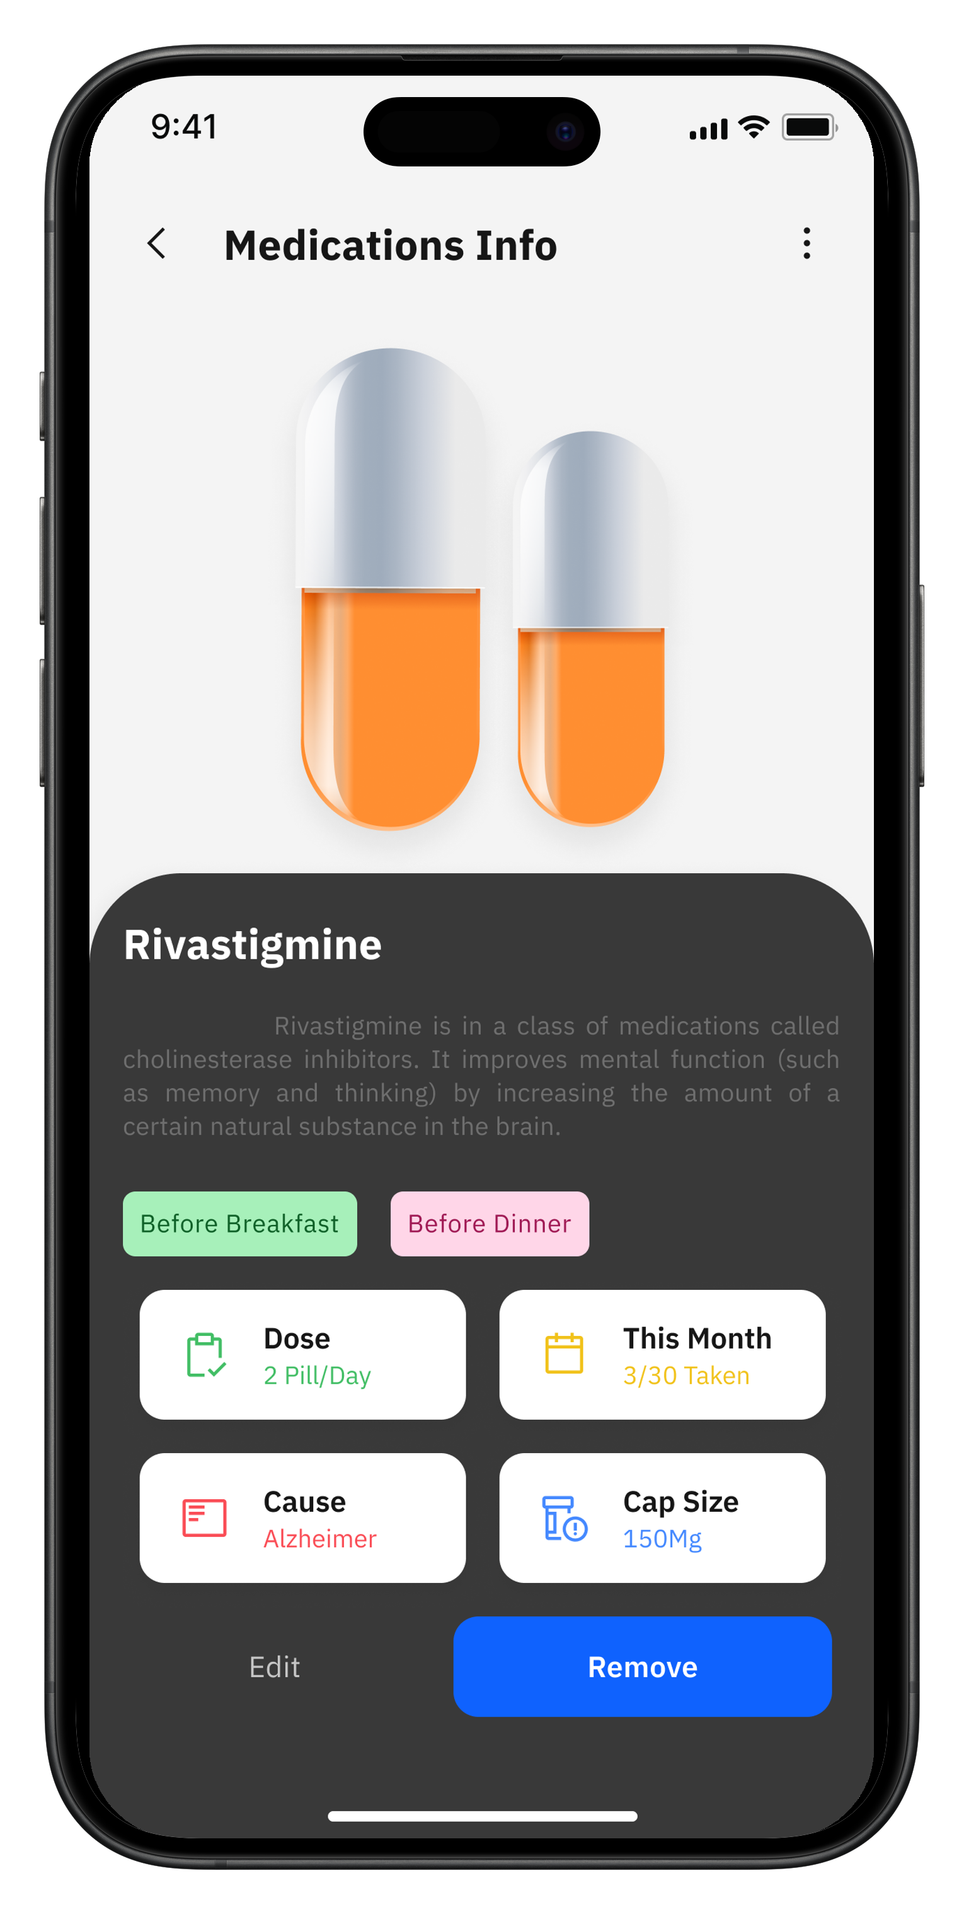
Medicine Reminder
Patient App
Caregiver App
28

Slide 28
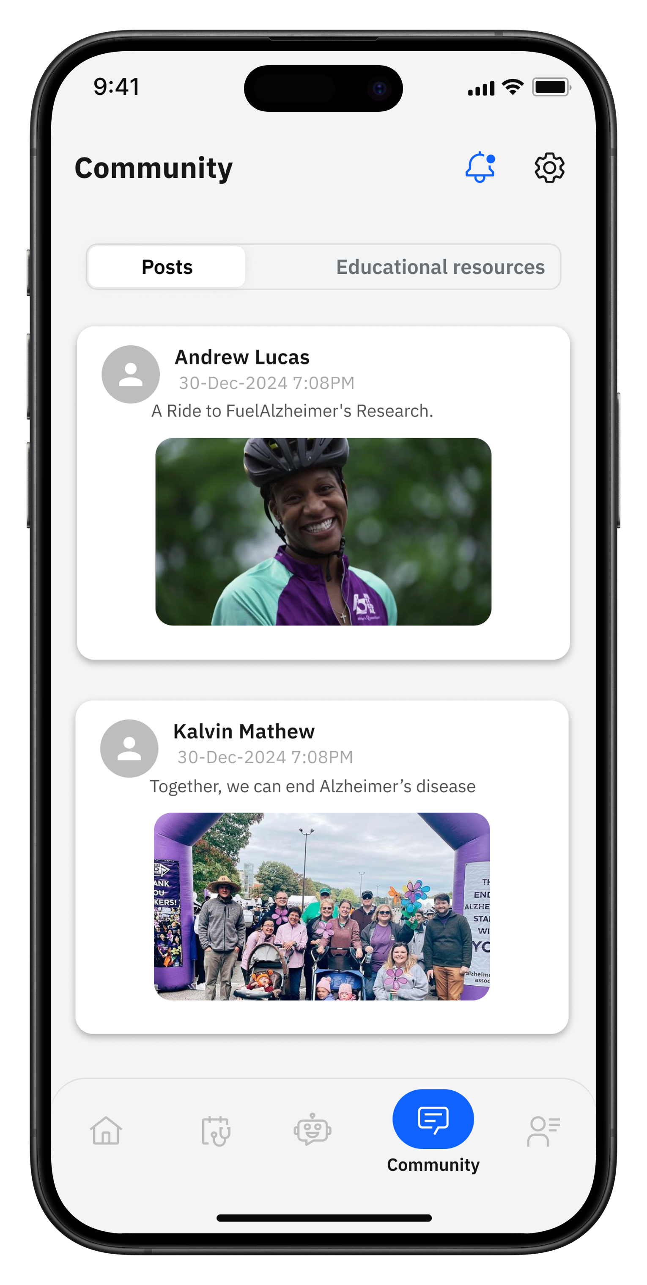
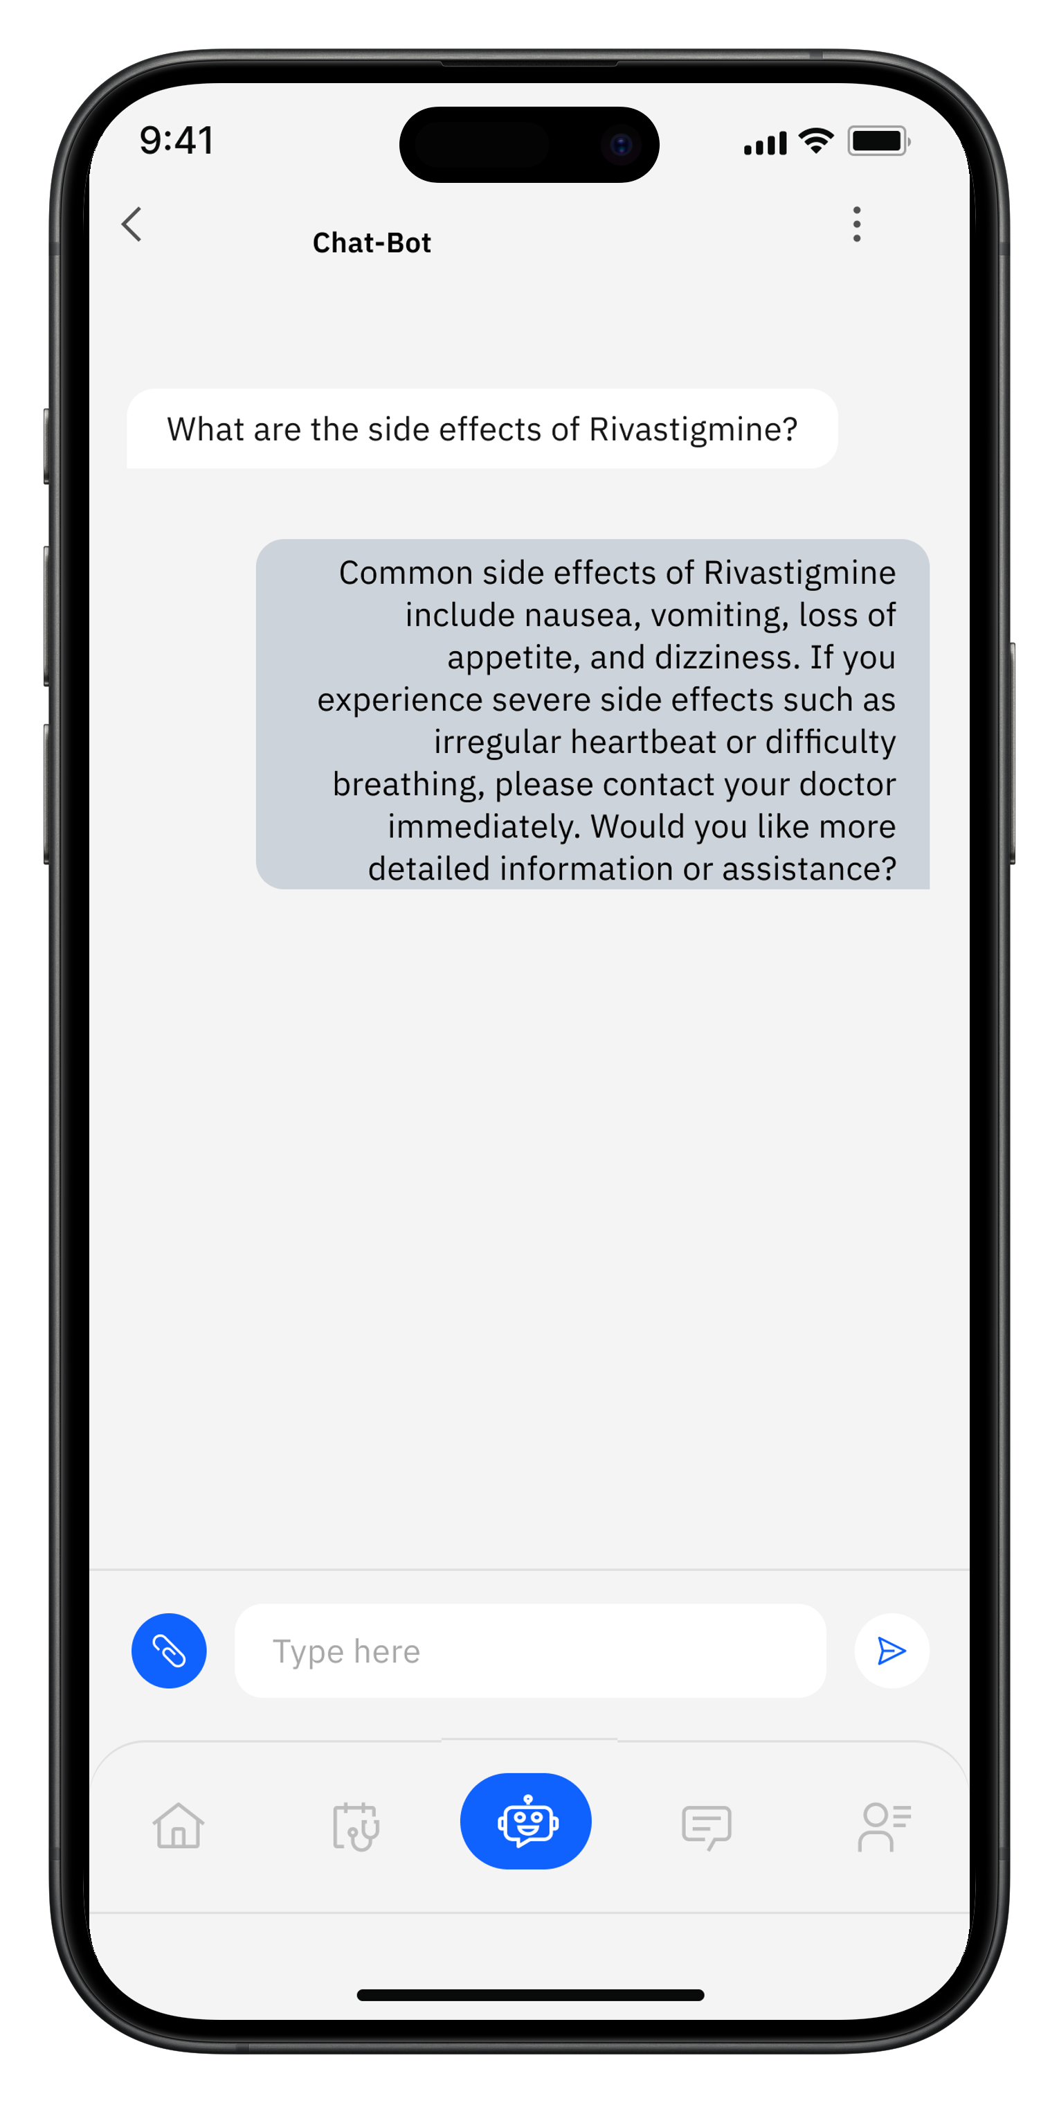
Community & AI Chatbot
Patient App
Caregiver App
29

Slide 29
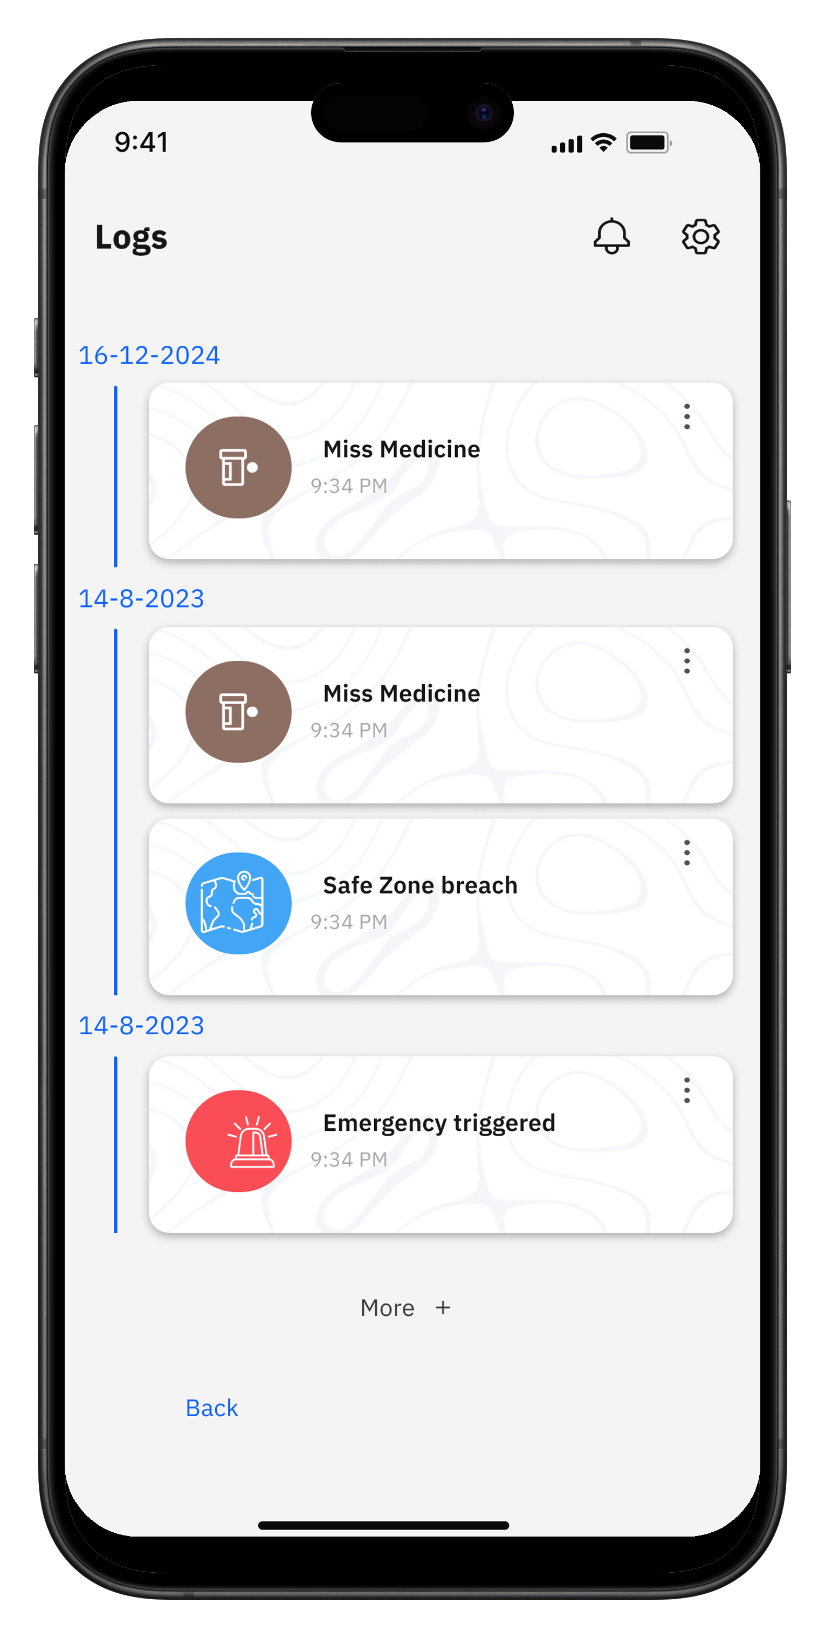
View Logs History
Caregiver App
29

Slide 30
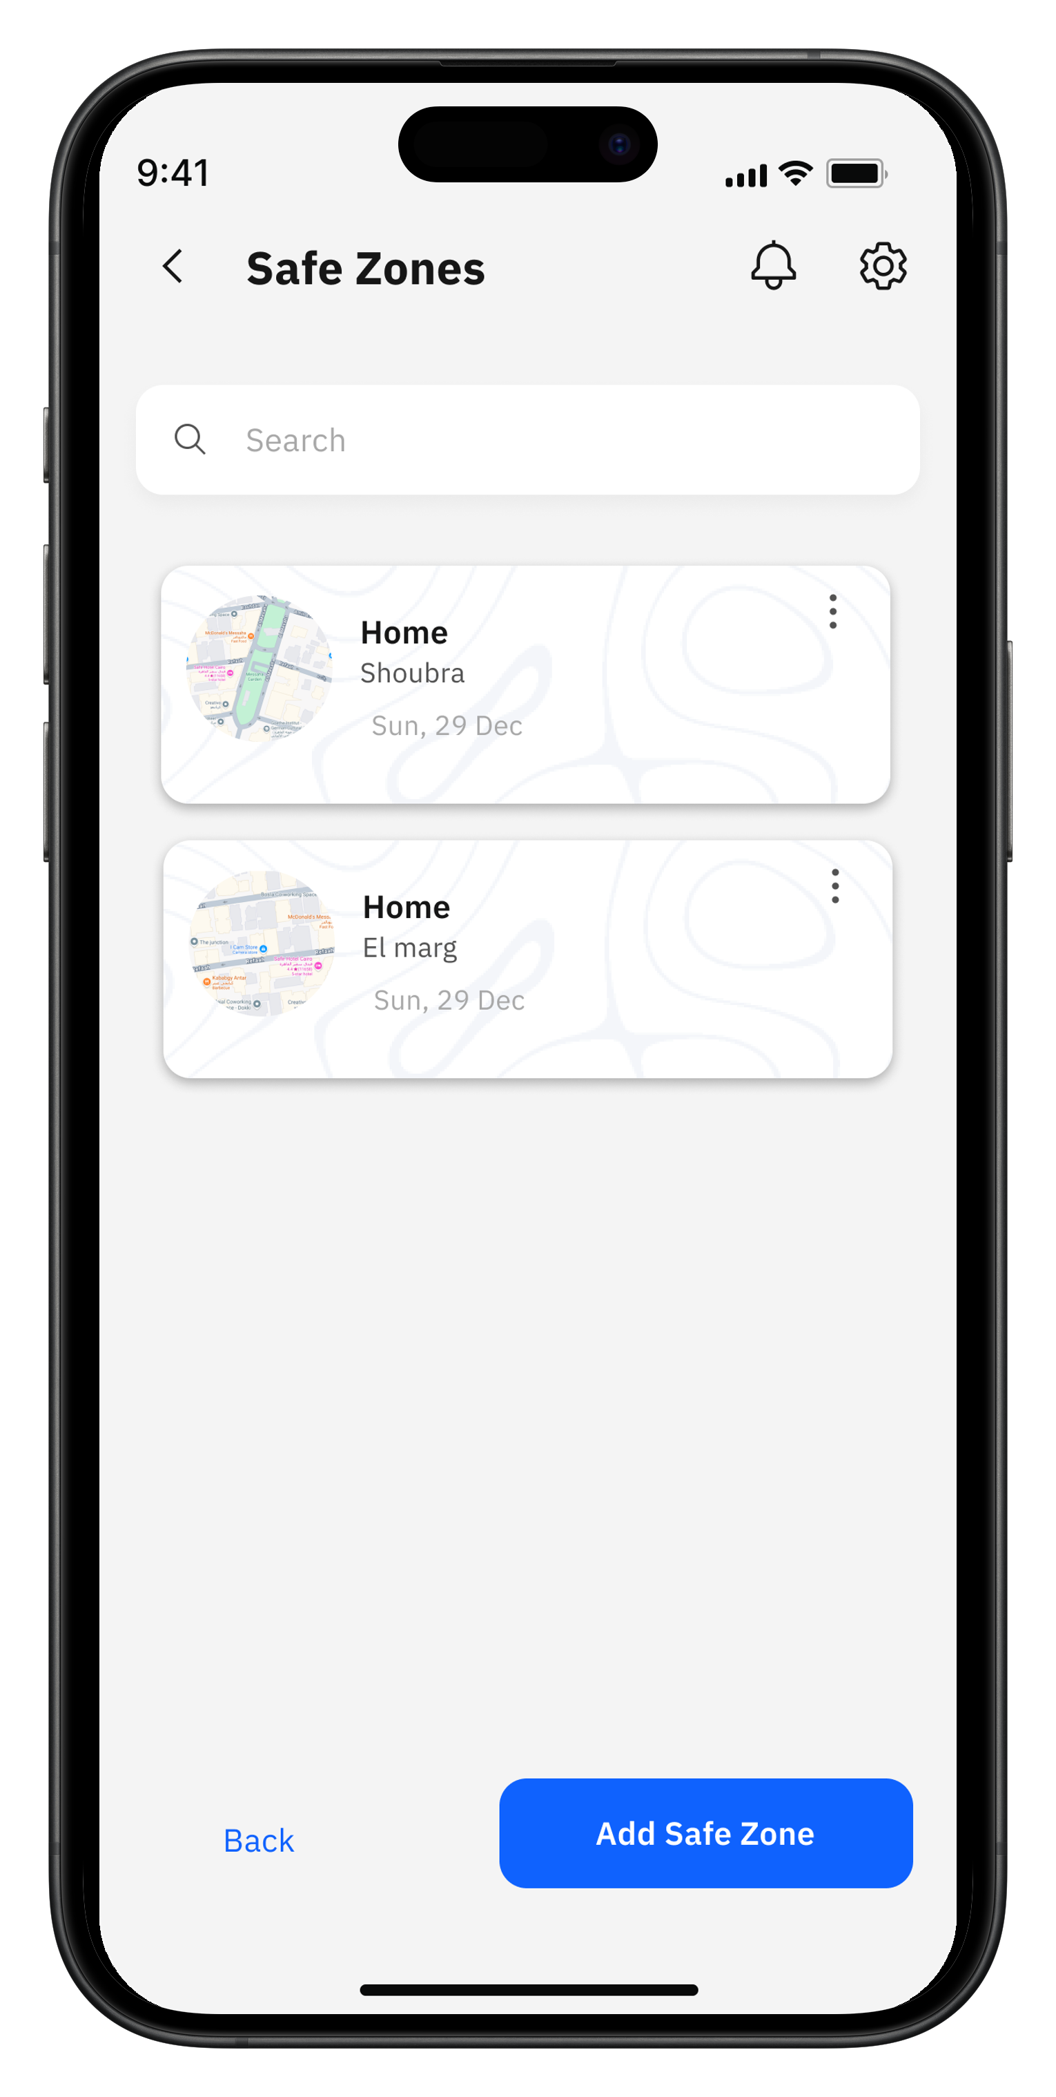
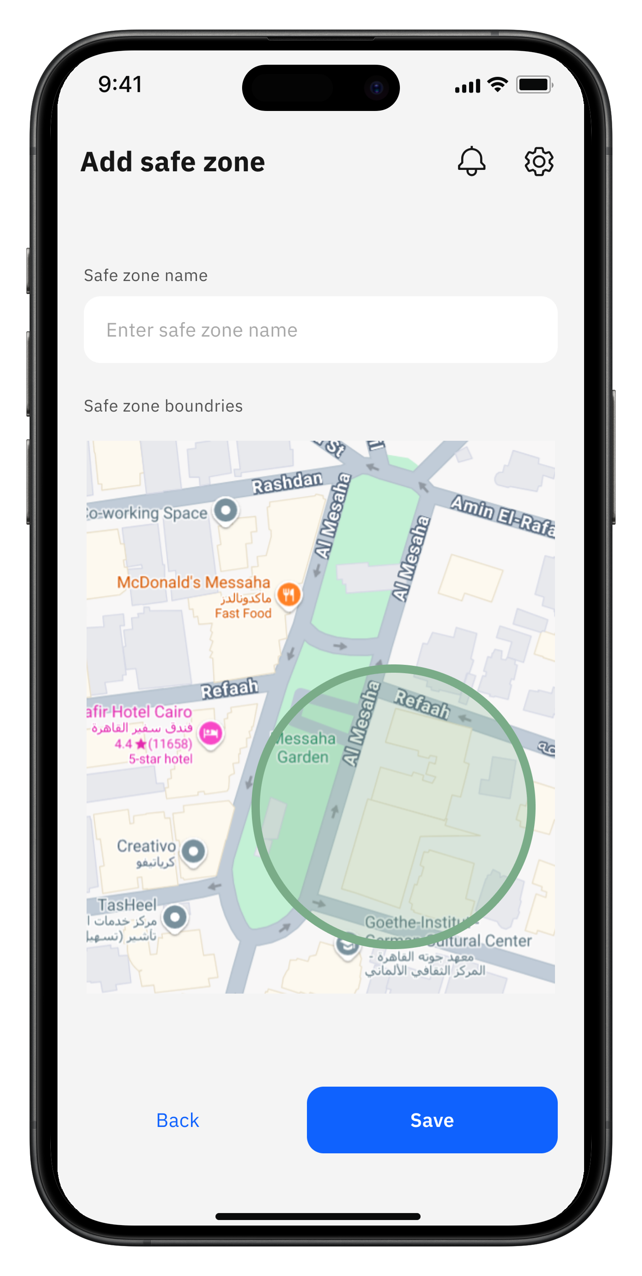
Safe Zones
Patient App
Caregiver App
30

Slide 31
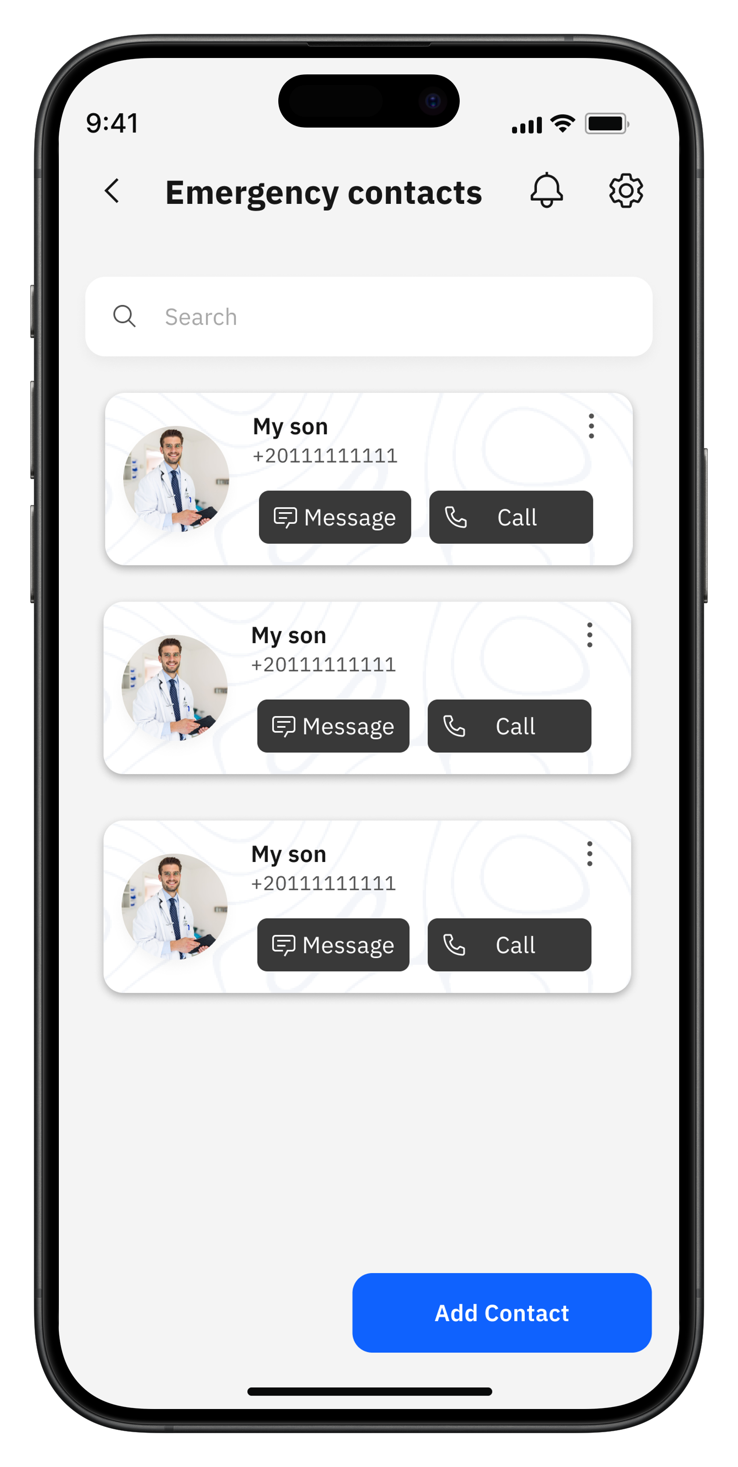
Emergency Contacts
Patient App
Caregiver App
30

Slide 32
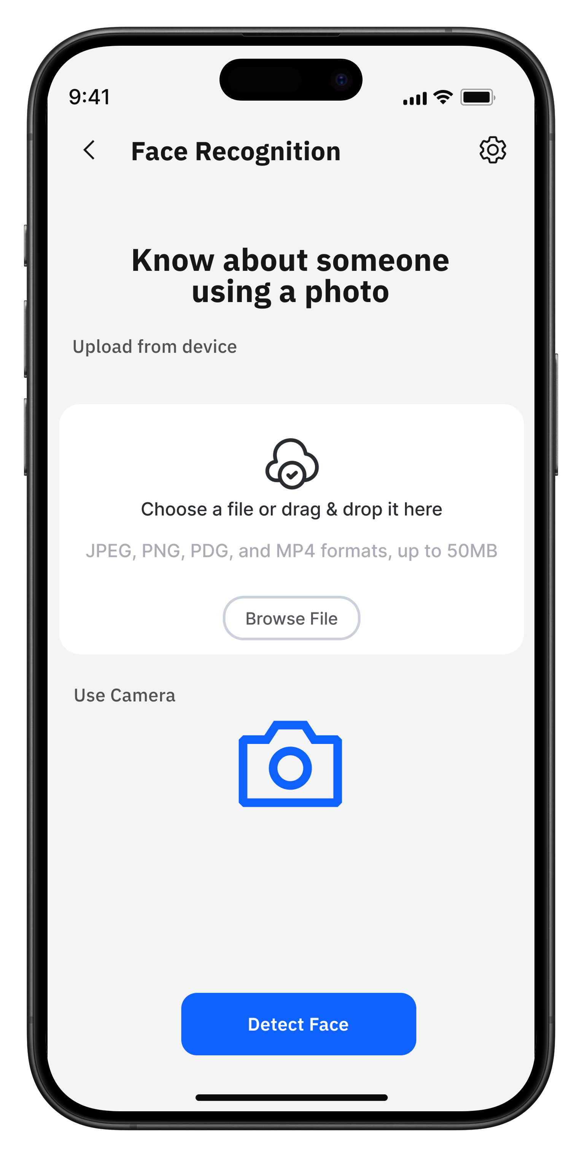
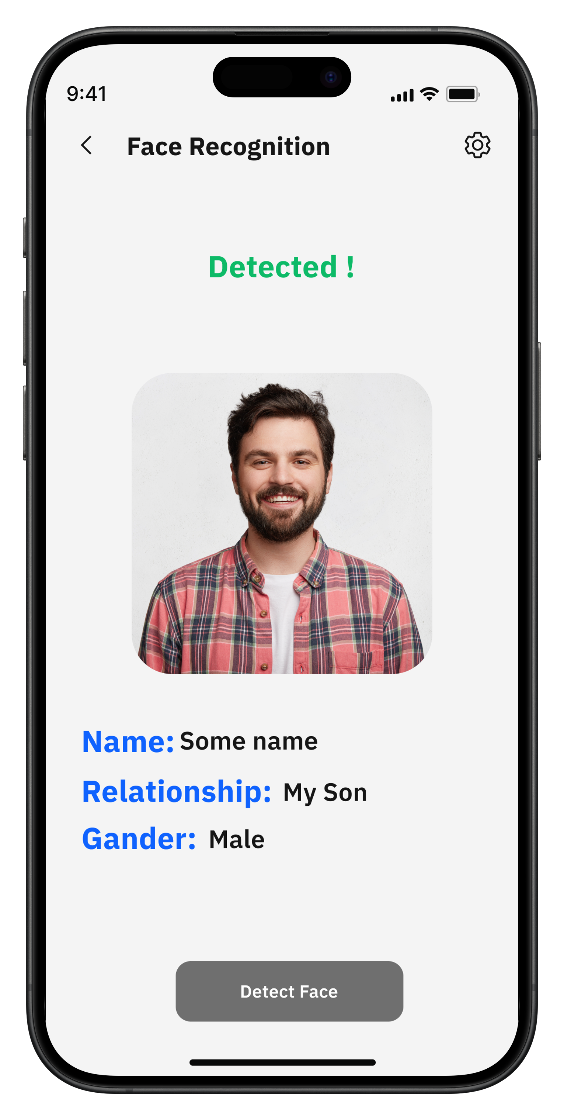
Face Recognition
Patient App
Caregiver App
30

Slide 33
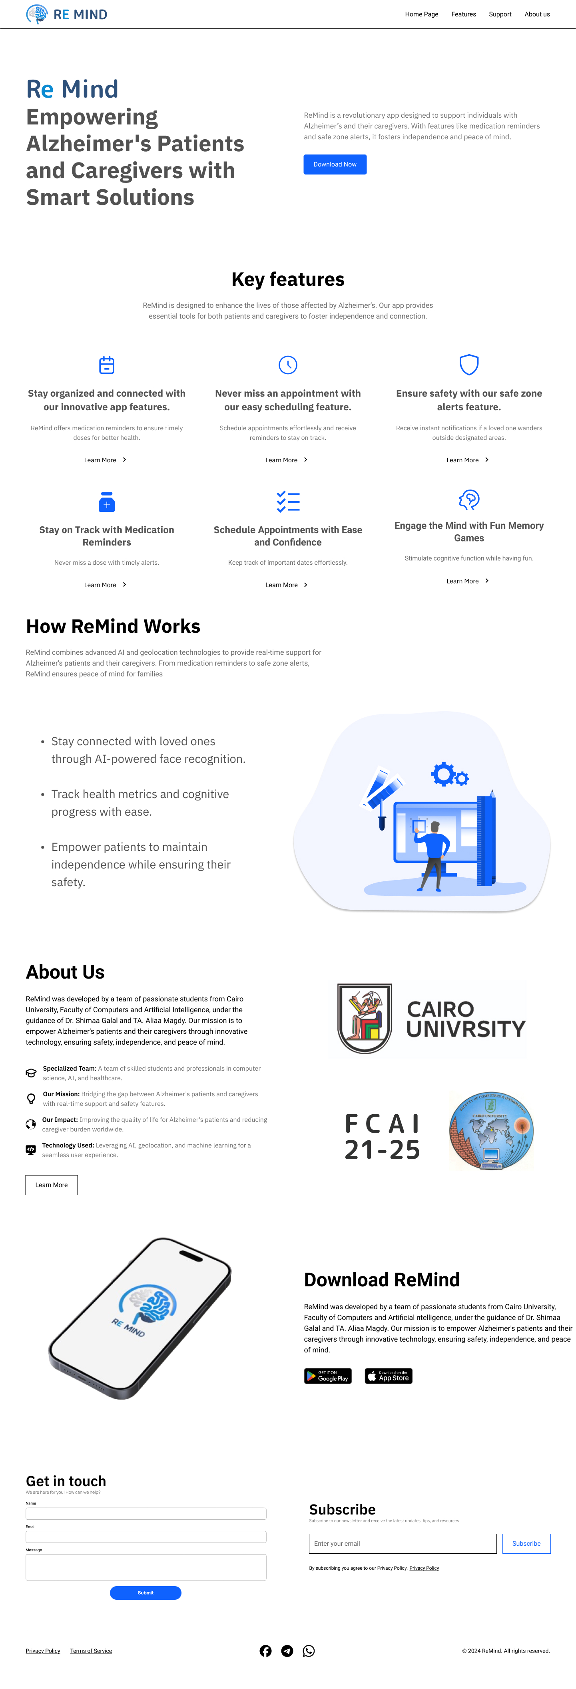
Landing website
31

Slide 35
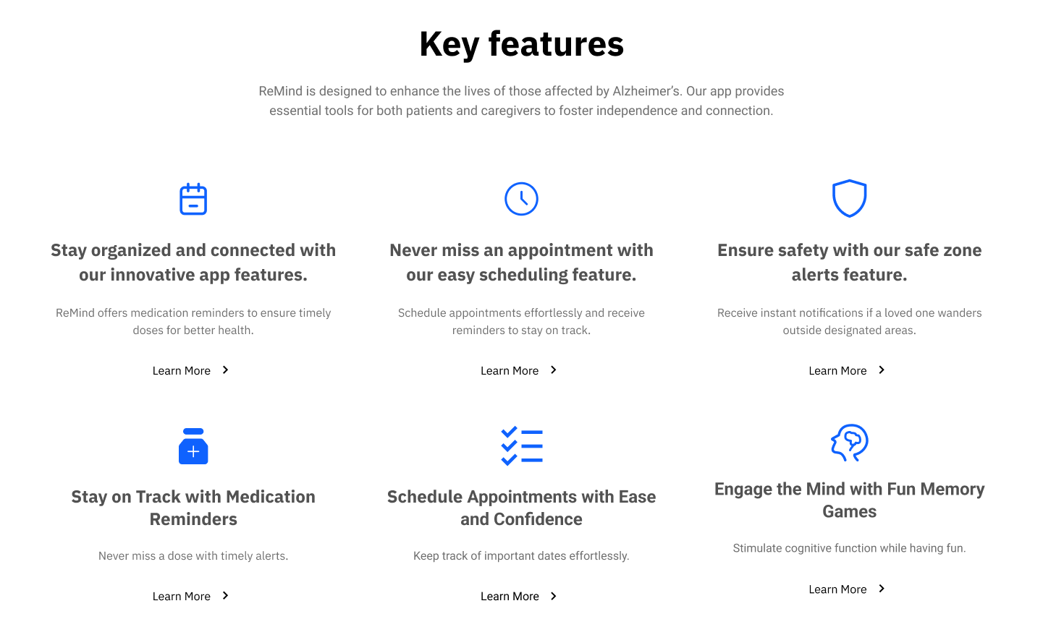
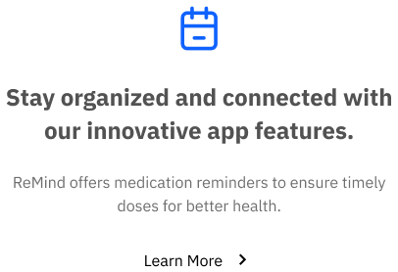
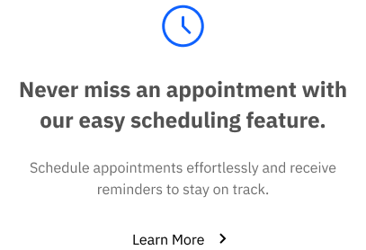
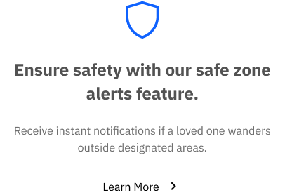
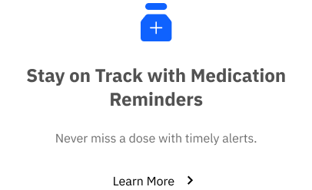
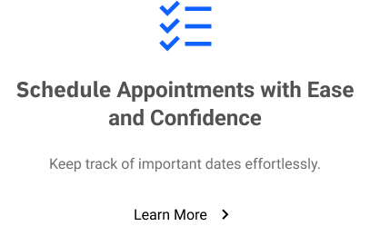
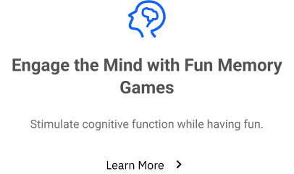

Slide 36
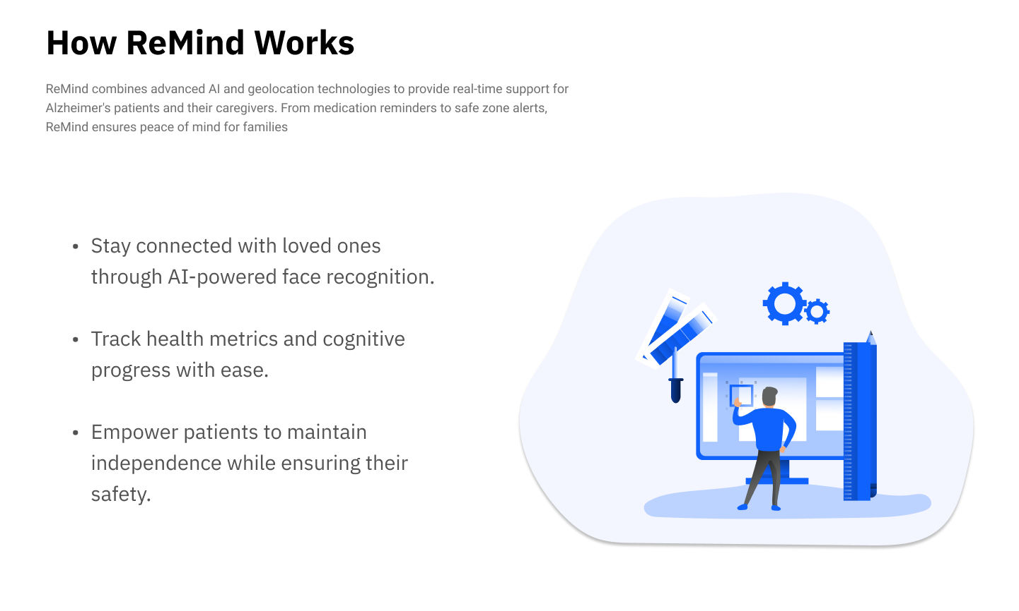

Slide 37
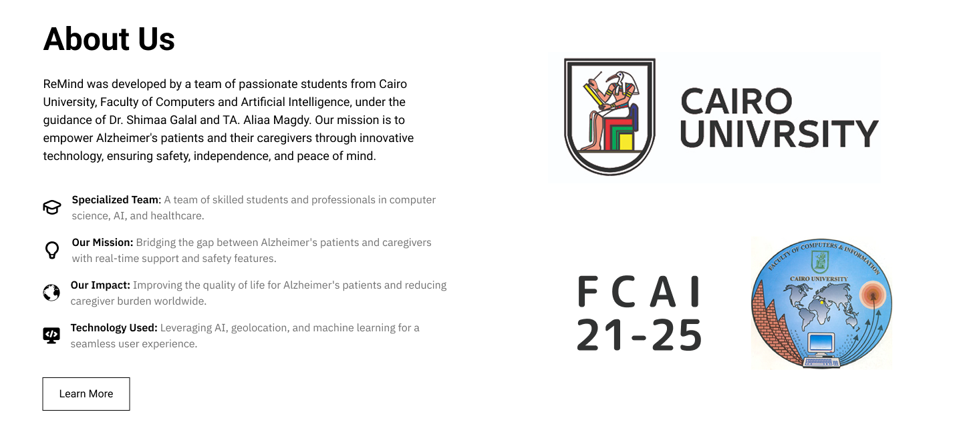

Slide 38
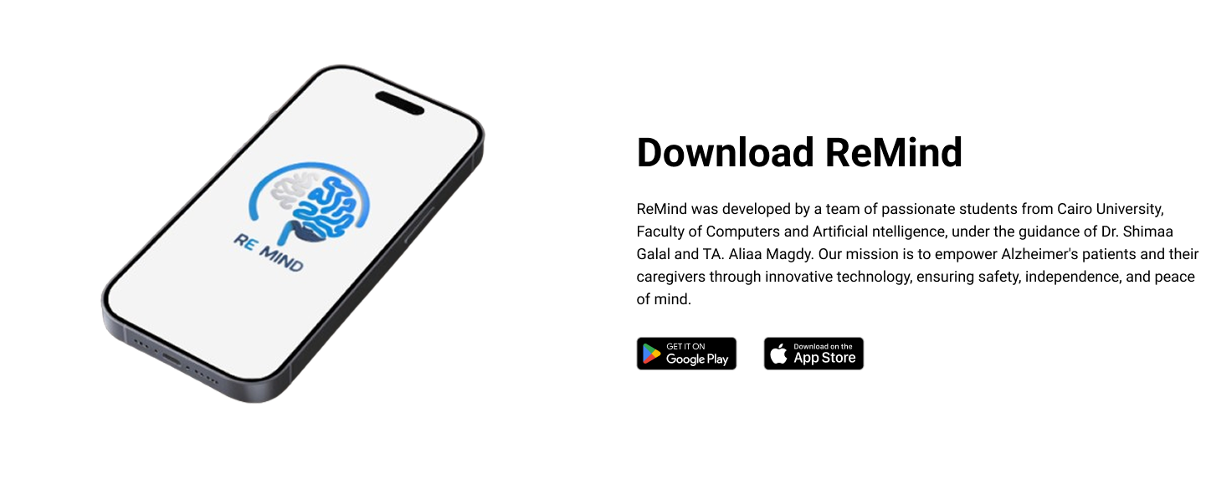

Slide 39
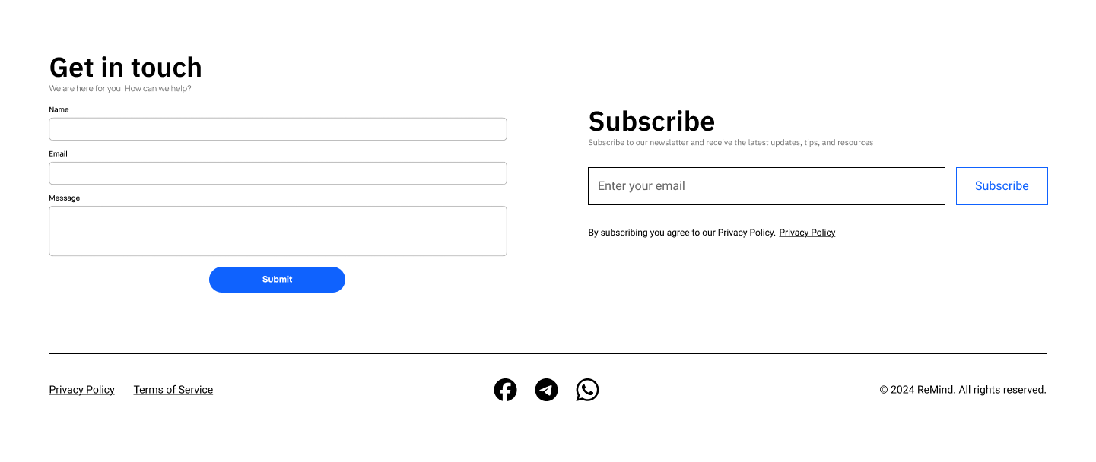

Slide 40



